Slide 1
Chapter Two
KINEMATICS AND DYNAMICS OF PARTICLES

Slide 2
Projectile Motion

Slide 8
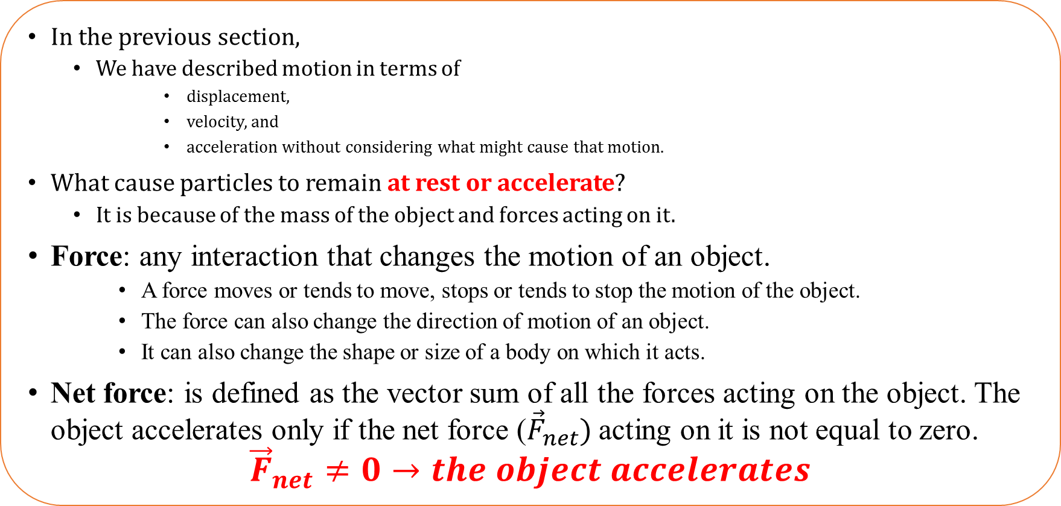
2.2. Particle Dynamics and Planetary Motion
In the previous section,
We have described motion in terms of
displacement,
velocity, and
acceleration without considering what might cause that motion.
What cause particles to remain at rest or accelerate?
It is because of the mass of the object and forces acting on it.
Force: any interaction that changes the motion of an object.
A force moves or tends to move, stops or tends to stop the motion of the object.
The force can also change the direction of motion of an object.
It can also change the shape or size of a body on which it acts.
Net force: is defined as the vector sum of all the forces acting on the object. The object accelerates only if the net force (${\vec{F}}_{net}$) acting on it is not equal to zero.
$${\vec{F}}_{net}≠0→the object accelerates$$

Slide 9
The Concept of Force as A Measure of Interaction
In physics, any of the four basic fundamental forces
Gravitational- purely attractive force, which can act over long distances
Electromagnetic- attractive and repulsive force, which acts on charged particles
Weak forces-acts on the scale of the atomic nucleus
Strong nuclear –stronger than the electromagnetic force on the scale of the atomic nucleus keeps protons and neutrons bound together in the nucleus.
govern how particles interact.
All other forces of nature can be traced to these fundamental interactions.
The fundamental interactions are characterized on the basis of the following four criteria:
The types of particles that experience the force,
The relative strength of the force,
The range over which the force is effective, and
The nature of the particles that mediate the force

Slide 10
Type of Forces
Forces
Contact
Non-Contact
Contact Force
It is a type of force that requires bodily contact with another object. And it is further divided into the following.
Muscular Forces
Muscles function to produce a resulting force which is known as “muscular force”.
Muscular force exists only when it is in contact with an object.
We apply muscular force during the basic day to day work of our life such as
breathing,
digestion, lifting a bucket,
pulling or pushing some object. Muscular force comes in handy to simply our work.
B. Frictional Forces
When an object changes its state of motion, “frictional force” acts upon.
It can be defined as the resisting force that exists when an object is moved or tries to move on a surface.
The frictional force acts as a point of contact between two surfaces that is it arises due to contact between two surfaces.
Examples; lighting a matchstick or stopping a moving ball come under frictional force.

Slide 11
Normal Force
When a book is lying on the table, even though it seems that it‘s stationary, it‘s not.
An opposing force is still acting on the book where in the force from gravity is pulling it towards the Earth. This force is the “normal force”.
They always act perpendicular to the surface.
1. Applied Force
When you push a table across the room, you apply a force that acts when it comes in contact with another object. This is “applied force”; i.e. a force that is applied to a person or object.
Tension Force
Tension is the force applied by a fully stretched cable or wire anchored on to an object. This causes a “tension force” that pulls equally in both directions and exerts equal pressure
Spring Force
Force exerted by a compressed or stretched spring is “spring force‘. The force created could be a push or pull depending on how the spring is attached.
Air Resistance Force
Air resisting forces are types of forces wherein objects experience a frictional force when moving through the air. These forces are resistive in nature

Slide 12
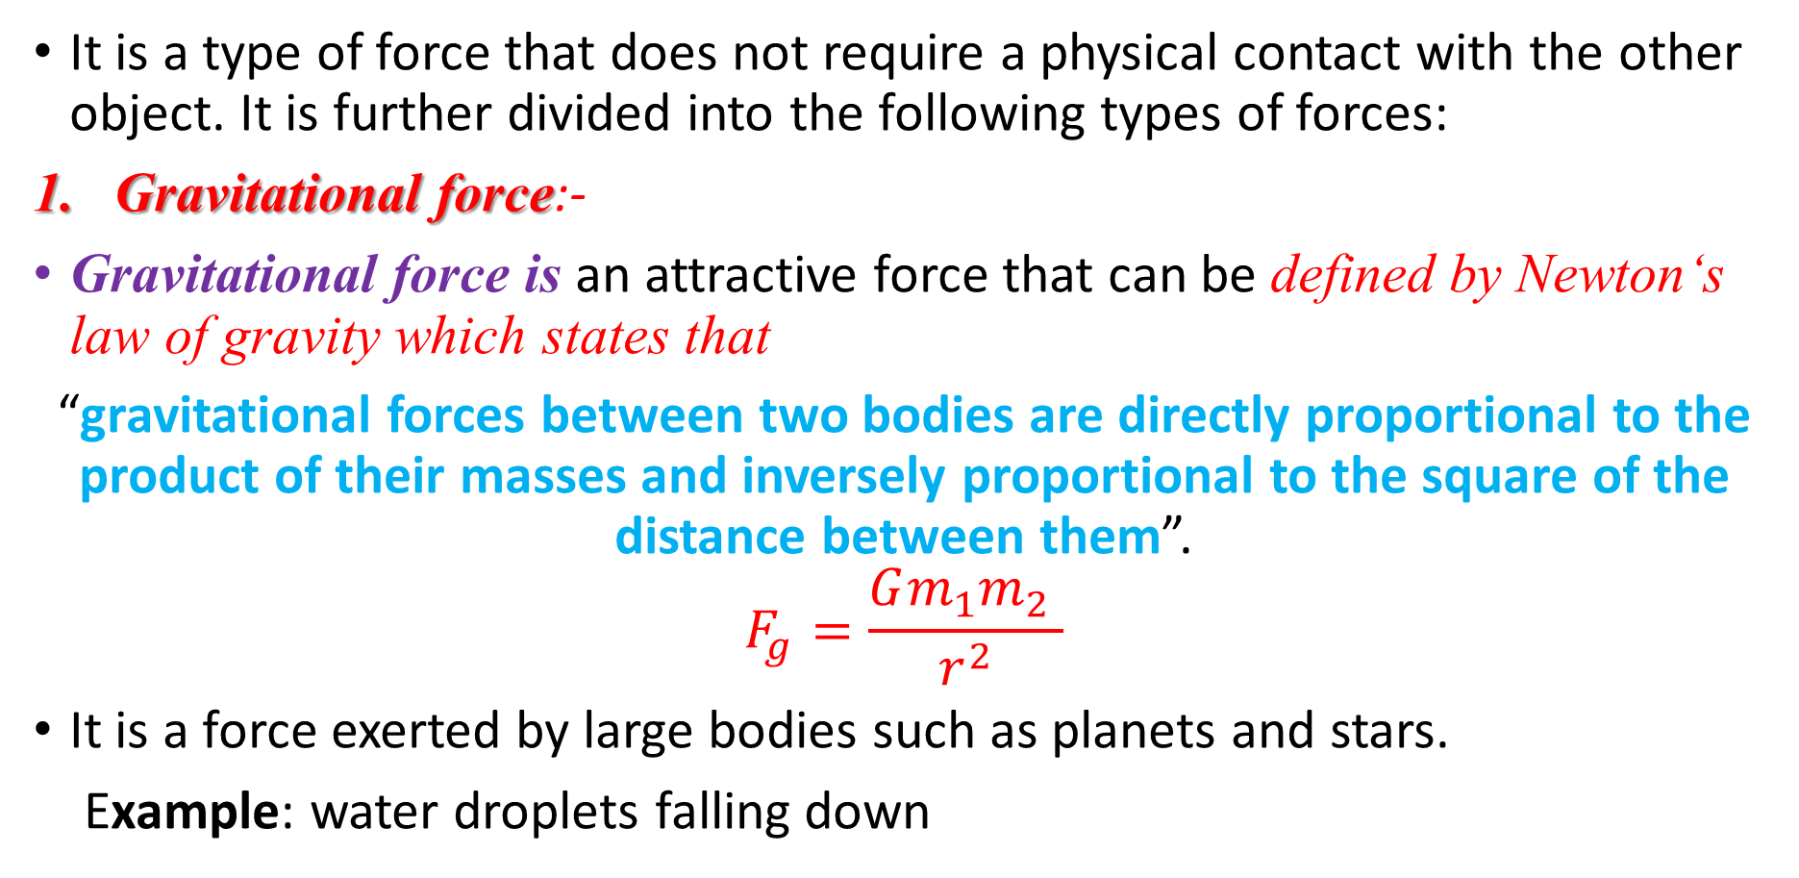
Non-Contact Force
It is a type of force that does not require a physical contact with the other object. It is further divided into the following types of forces:
Gravitational force:-
Gravitational force is an attractive force that can be defined by Newton‘s law of gravity which states that
“gravitational forces between two bodies are directly proportional to the product of their masses and inversely proportional to the square of the distance between them”.
$$F_{g}=\frac{Gm_{1}m_{2} }{r^{2}}$$
It is a force exerted by large bodies such as planets and stars.
Example: water droplets falling down

Slide 13
cont……….
2. Magnetic Force
The types of forces exerted by a magnet on magnetic objects are “magnetic forces”.
They exist without any contact between two objects.
3. Electrostatic Force
The types of forces exerted by all electrically charged bodies on another charged bodies in the universe are “electrostatic forces”.
These forces can be both attractive and repulsive in nature based on the type of charge carried by the bodies.

Slide 14
2.2.3. Newton’s Laws of Motion and Applications
Laws of motions are formulated for the first time by English physicist Sir Isaac Newton in 1687.
Newton developed the three laws of motion in order to explain why the orbits of the planets are ellipses rather than circles, at which he succeeded.
Newton‘s laws continue to give an accurate account of nature, except for very small bodies such as electrons or for bodies moving close to the speed of light.

Slide 15
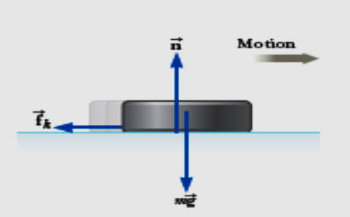
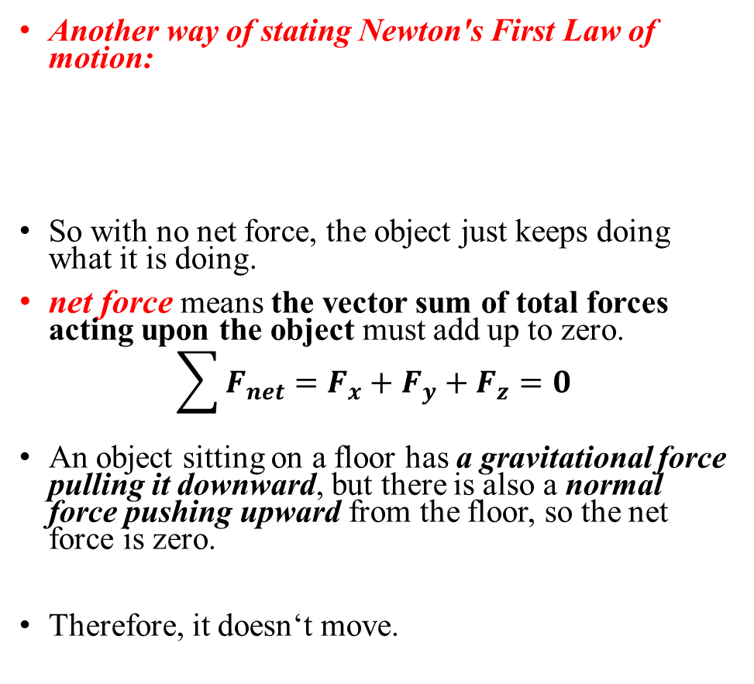
Newton’s First law of Motion:
States that
“Everybody continues in its state of rest or of uniform motion in a straight line unless it is compelled to change that state by forces impressed upon it.”
This is sometimes called the Law of Inertia.
Essentially, it makes the following two points:
An object that is not in motion will not move until a force acting upon it.
An object in constant motion will not change its velocity until a force acts upon it.
Another way of stating Newton's First Law of motion:
So with no net force, the object just keeps doing what it is doing.
net force means the vector sum of total forces acting upon the object must add up to zero.
$$\sum{F_{net}}=F_{x}+F_{y}+F_{z}=0$$
An object sitting on a floor has a gravitational force pulling it downward, but there is also a normal force pushing upward from the floor, so the net force is zero.
Therefore, it doesn‘t move.
“Every body continues in its state of rest or of uniform motion in a straight line unless it is compelled to change that state by forces impressed upon it.”
A body that is acted on by no net force moves at a constant velocity (which may be zero) and zero acceleration.

Slide 16
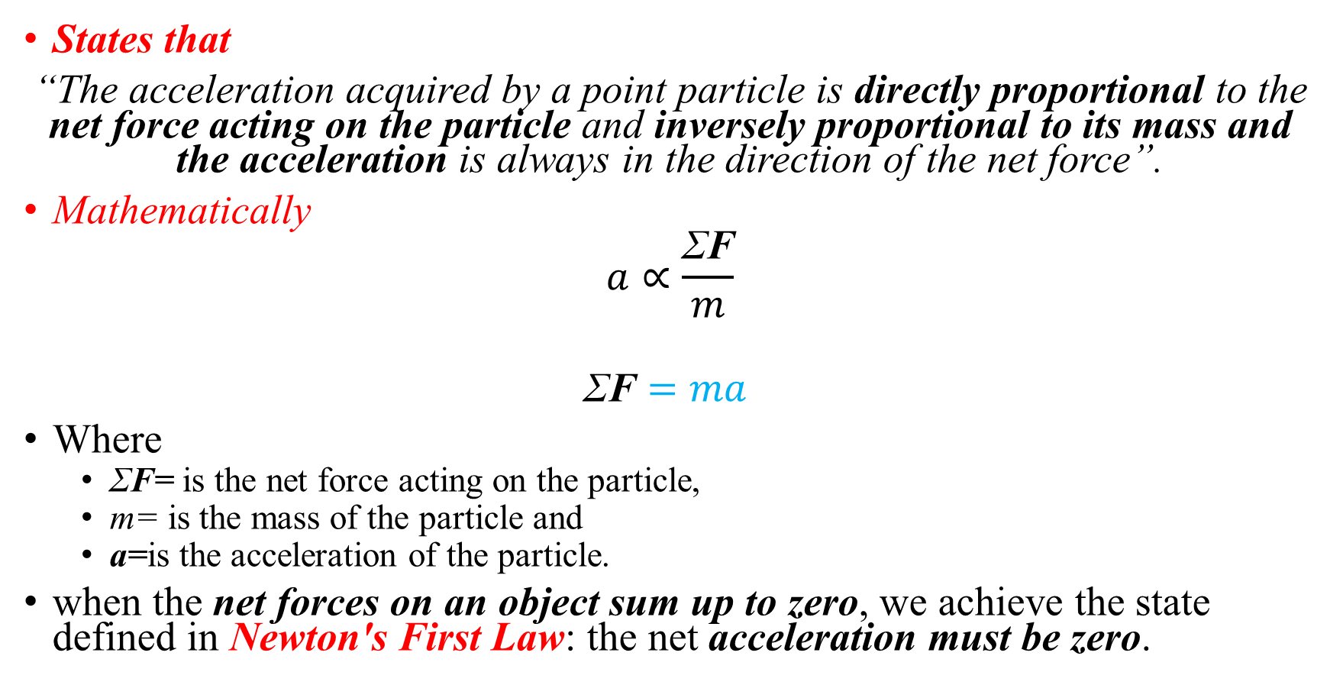
Newton's Second law of Motion:
States that
“The acceleration acquired by a point particle is directly proportional to the net force acting on the particle and inversely proportional to its mass and the acceleration is always in the direction of the net force”.
Mathematically
$$a∝\frac{\text{Σ}\text{F}}{m}$$
$$\text{Σ}\text{F}=ma$$
Where
ΣF= is the net force acting on the particle,
m= is the mass of the particle and
a=is the acceleration of the particle.
when the net forces on an object sum up to zero, we achieve the state defined in Newton's First Law: the net acceleration must be zero.

Slide 17
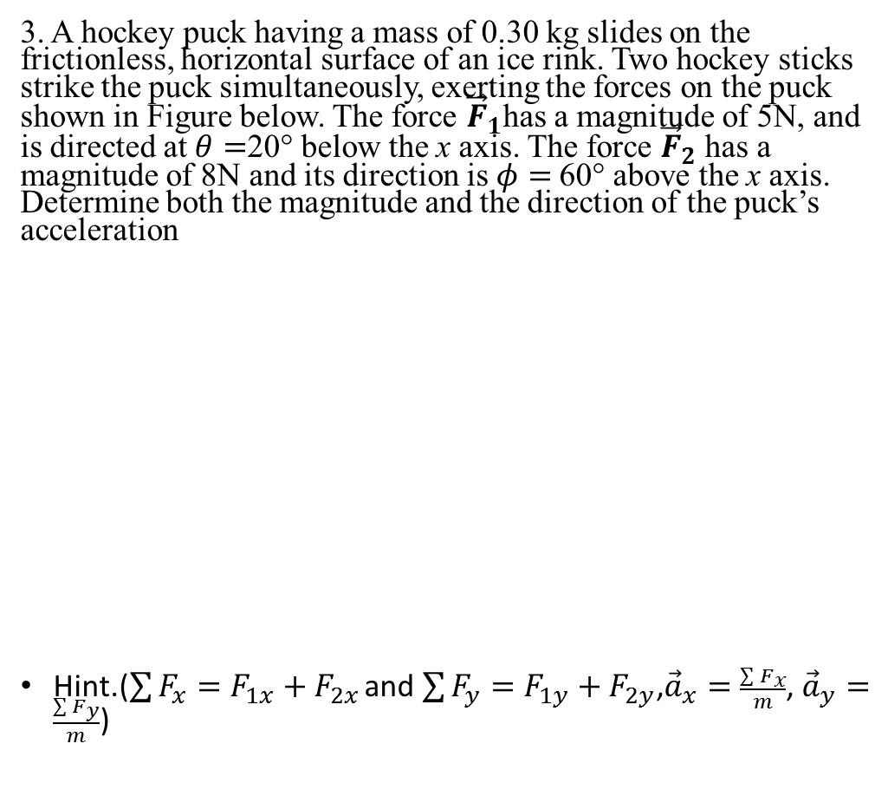
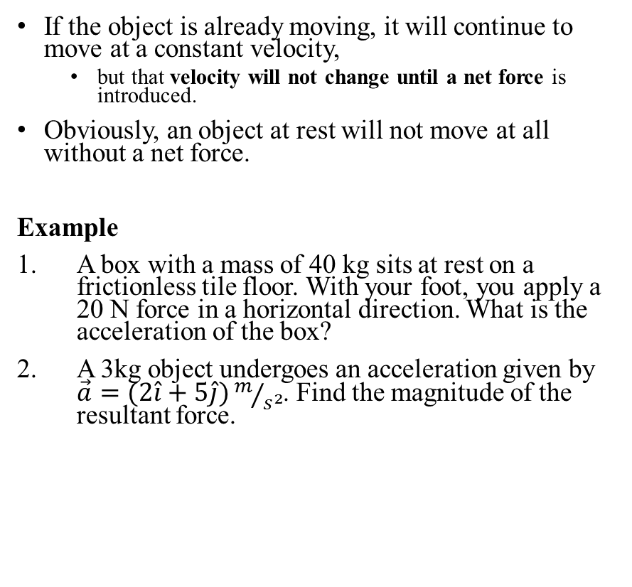
Cont……
If the object is already moving, it will continue to move at a constant velocity,
but that velocity will not change until a net force is introduced.
Obviously, an object at rest will not move at all without a net force.
Example
A box with a mass of 40 kg sits at rest on a frictionless tile floor. With your foot, you apply a 20 N force in a horizontal direction. What is the acceleration of the box?
A 3kg object undergoes an acceleration given by $\vec{a}=(2\hat{i}+5\hat{j})m/{s^{2}}$. Find the magnitude of the resultant force.
3. A hockey puck having a mass of 0.30 kg slides on the frictionless, horizontal surface of an ice rink. Two hockey sticks strike the puck simultaneously, exerting the forces on the puck shown in Figure below. The force ${\vec{F}}_{1}$has a magnitude of 5N, and is directed at $θ=$20° below the x axis. The force ${\vec{F}}_{2}$ has a magnitude of 8N and its direction is $φ=$60° above the x axis. Determine both the magnitude and the direction of the puck’s acceleration
Hint.($\sum{F_{x}}=F_{1x}+F_{2x}$ and $\sum{F_{y}}=F_{1y}+F_{2y}$,${\vec{a}}_{x}=\frac{\sum{F_{x}}}{m}$, ${\vec{a}}_{y}=\frac{\sum{F_{y}}}{m}$)

Slide 18
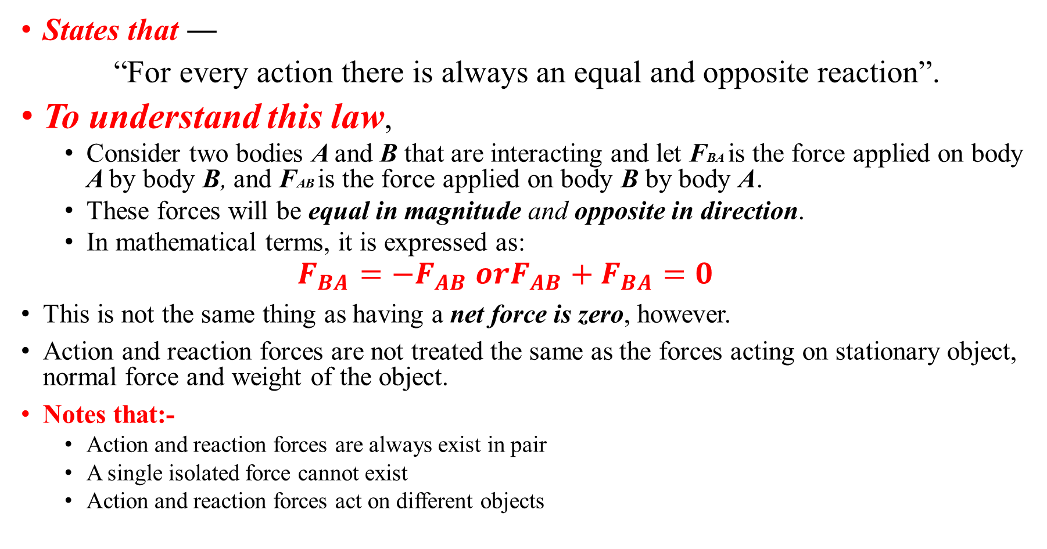
Newton's Third law of Motion
States that ―
“For every action there is always an equal and opposite reaction”.
To understand this law,
Consider two bodies A and B that are interacting and let FBA is the force applied on body A by body B, and FAB is the force applied on body B by body A.
These forces will be equal in magnitude and opposite in direction.
In mathematical terms, it is expressed as:
$$F_{BA}={−F}_{AB} or{F_{AB}+F}_{BA}=0$$
This is not the same thing as having a net force is zero, however.
Action and reaction forces are not treated the same as the forces acting on stationary object, normal force and weight of the object.
Notes that:-
Action and reaction forces are always exist in pair
A single isolated force cannot exist
Action and reaction forces act on different objects

Slide 19
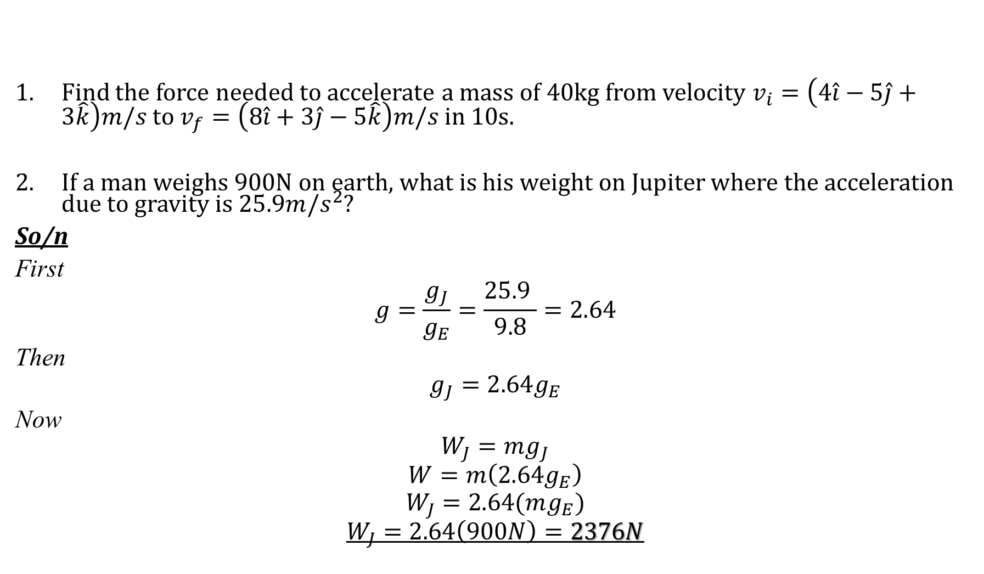
Exercise
Find the force needed to accelerate a mass of 40kg from velocity $v_{i}=\left(4\hat{i}−5\hat{j}+3\hat{k}\right)m/s$ to $v_{f}=\left(8\hat{i}+3\hat{j}−5\hat{k}\right)m/s$ in 10s.
If a man weighs 900N on earth, what is his weight on Jupiter where the acceleration due to gravity is $25.9m/s^{2}$?
So/n
First
$$g=\frac{g_{J}}{g_{E}}=\frac{25.9 }{9.8}=2.64$$
Then
$$g_{J}=2.64g_{E}$$
Now
$$W_{J}=mg_{J}$$
$$W=m\left(2.64g_{E}\right)$$
$$W_{J}=2.64(mg_{E})$$
$$W_{J}=2.64\left(900N\right)=2376N$$

Slide 20
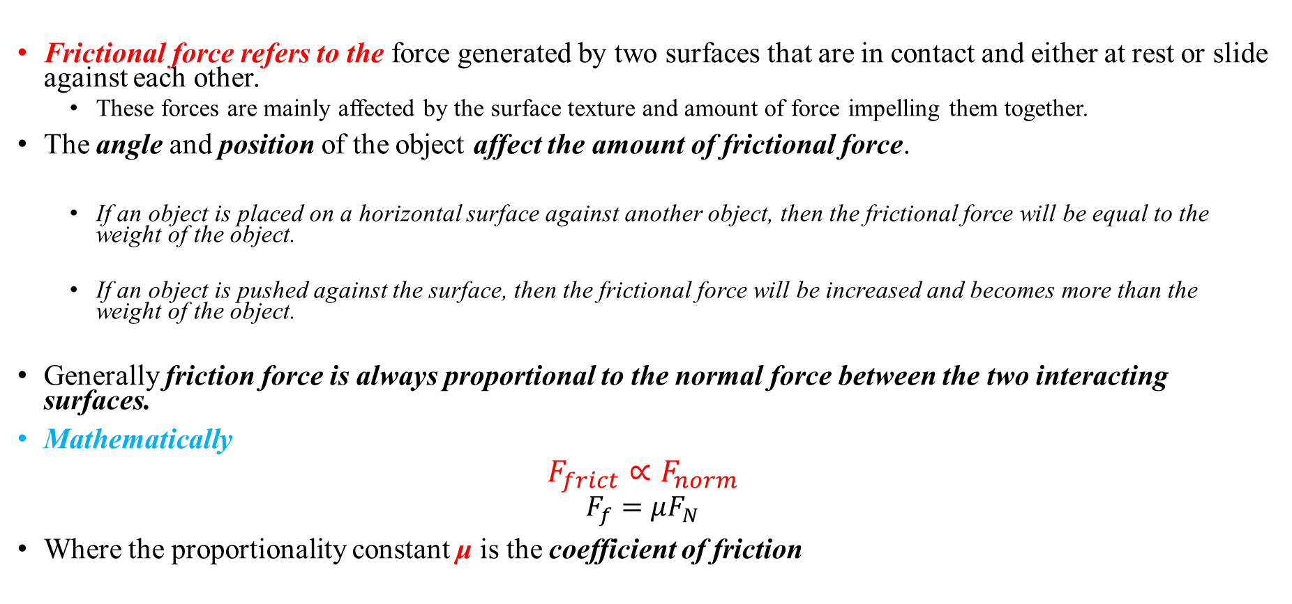
Forces of Friction
Frictional force refers to the force generated by two surfaces that are in contact and either at rest or slide against each other.
These forces are mainly affected by the surface texture and amount of force impelling them together.
The angle and position of the object affect the amount of frictional force.
If an object is placed on a horizontal surface against another object, then the frictional force will be equal to the weight of the object.
If an object is pushed against the surface, then the frictional force will be increased and becomes more than the weight of the object.
Generally friction force is always proportional to the normal force between the two interacting surfaces.
Mathematically
$$F_{frict}∝F_{norm}$$
$$F_{f}=μF_{N}$$
Where the proportionality constant μ is the coefficient of friction

Slide 21
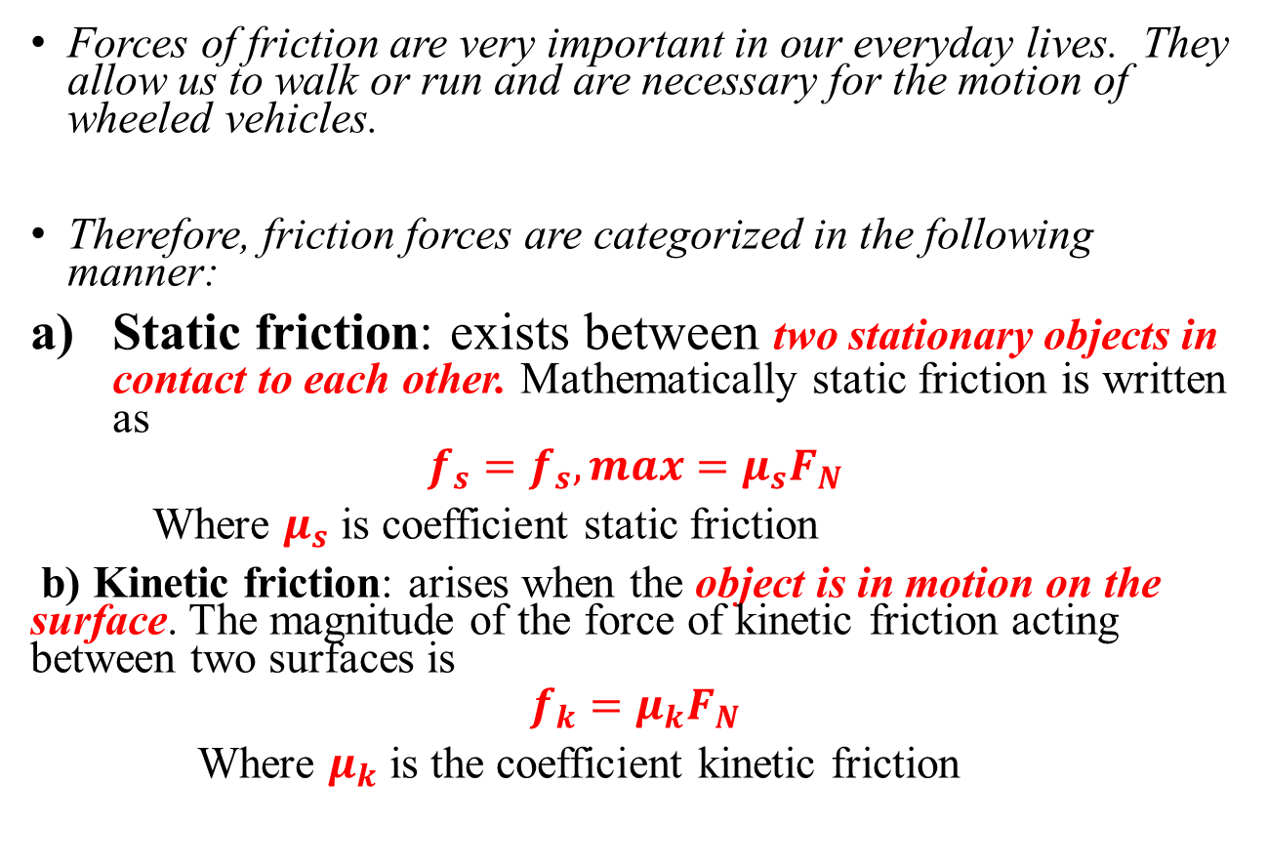
Cont……
Forces of friction are very important in our everyday lives. They allow us to walk or run and are necessary for the motion of wheeled vehicles.
Therefore, friction forces are categorized in the following manner:
Static friction: exists between two stationary objects in contact to each other. Mathematically static friction is written as
$$f_{s}=f_{s},max=μ_{s}F_{N}$$
Where $μ_{s}$ is coefficient static friction
b) Kinetic friction: arises when the object is in motion on the surface. The magnitude of the force of kinetic friction acting between two surfaces is
$$f_{k}=μ_{k}F_{N}$$
Where $μ_{k}$ is the coefficient kinetic friction

Slide 22
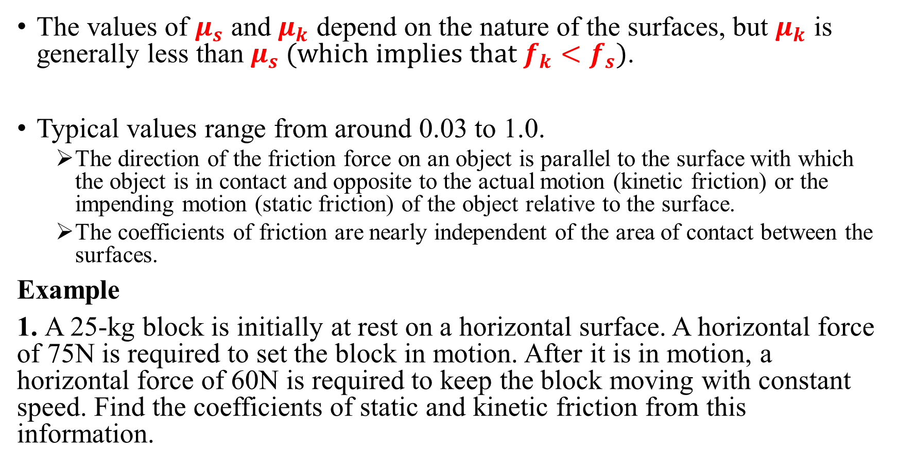
Cont….
The values of $μ_{s}$ and $μ_{k}$ depend on the nature of the surfaces, but $μ_{k}$ is generally less than $μ_{s}$(which implies that $f_{k}<f_{s}$).
Typical values range from around 0.03 to 1.0.
The direction of the friction force on an object is parallel to the surface with which the object is in contact and opposite to the actual motion (kinetic friction) or the impending motion (static friction) of the object relative to the surface.
The coefficients of friction are nearly independent of the area of contact between the surfaces.
Example
1. A 25-kg block is initially at rest on a horizontal surface. A horizontal force of 75N is required to set the block in motion. After it is in motion, a horizontal force of 60N is required to keep the block moving with constant speed. Find the coefficients of static and kinetic friction from this information.

Slide 23
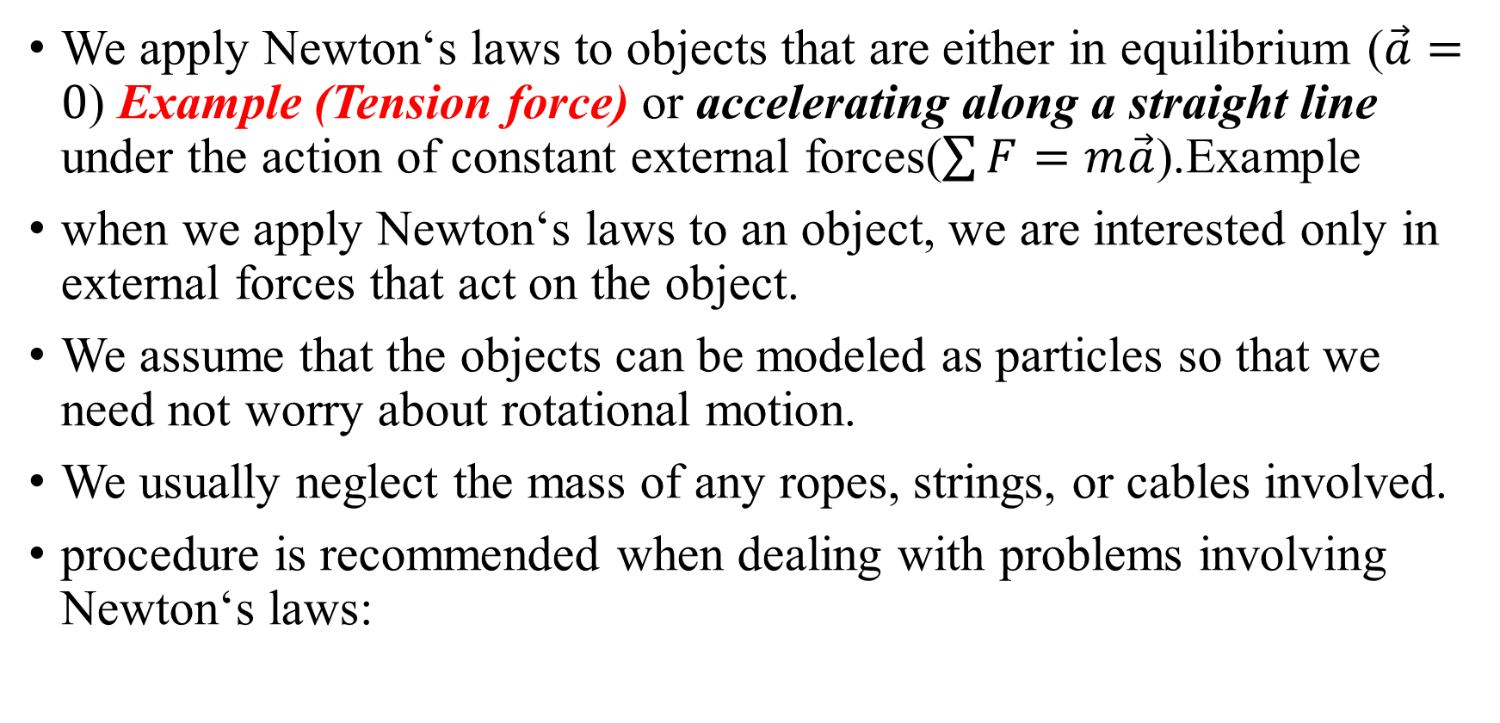
Application of Newton’s Laws of Motion
We apply Newton‘s laws to objects that are either in equilibrium ($\vec{a}=0$) Example (Tension force) or accelerating along a straight line under the action of constant external forces($\sum{F}=m\vec{a}$).Example
when we apply Newton‘s laws to an object, we are interested only in external forces that act on the object.
We assume that the objects can be modeled as particles so that we need not worry about rotational motion.
We usually neglect the mass of any ropes, strings, or cables involved.
procedure is recommended when dealing with problems involving Newton‘s laws:
Are a=constant and a=0 the same?
NO. Because zero acceleration means no change of acceleration. That is no increase or decrease of acceleration throughout the path. In the other hand constant acceleration means constant increase or decrease of acceleration.

Slide 24
Procedure is recommended when dealing with problems involving Newton‘s laws:
Draw a sketch of the situation.
Consider only one object (at a time), and draw a free-body diagram for that body, showing all the forces acting on that body.
Newton's second law involves vectors, and it is usually important to resolve vectors into components. Choose an x and y axis in a way that simplifies the calculation.
For each body, Newton's second law can be applied to the x and y components separately. That is the x component of the net force on that body will be related to the x component of that body's acceleration: Fx=max, and similarly for the y direction.
Solve the equation or equations for the unknown(s).

Slide 25
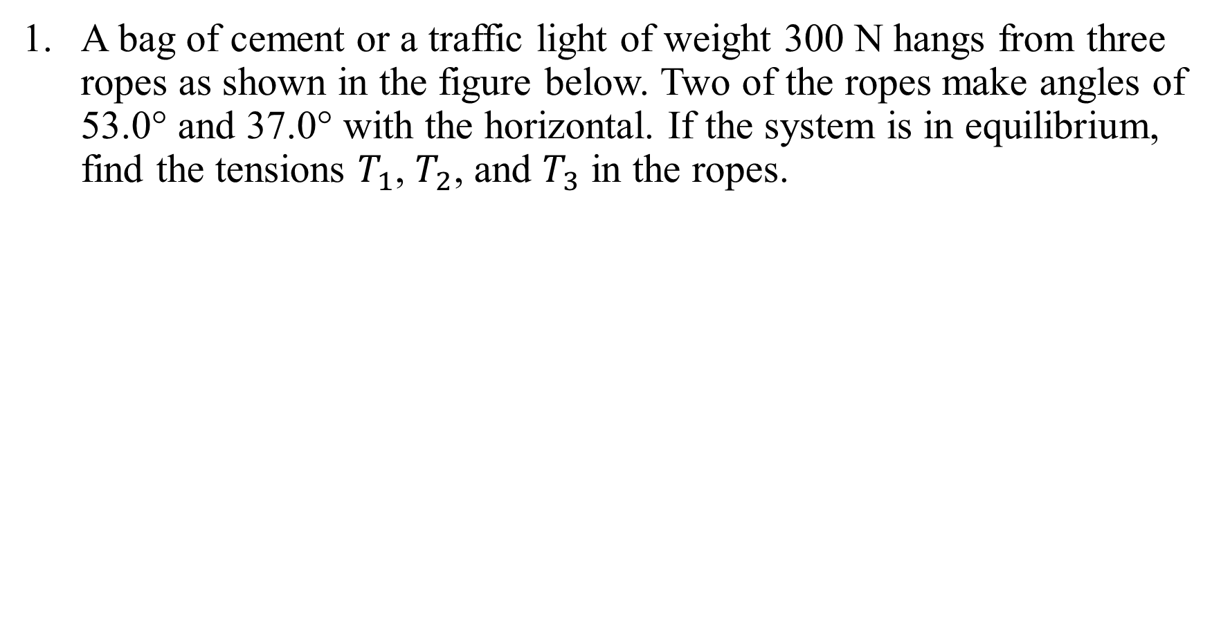
Example For System in Equilibrium
A bag of cement or a traffic light of weight 300 N hangs from three ropes as shown in the figure below. Two of the ropes make angles of 53.0° and 37.0° with the horizontal. If the system is in equilibrium, find the tensions $T_{1}$, $T_{2}$, and $T_{3}$ in the ropes.

Slide 26
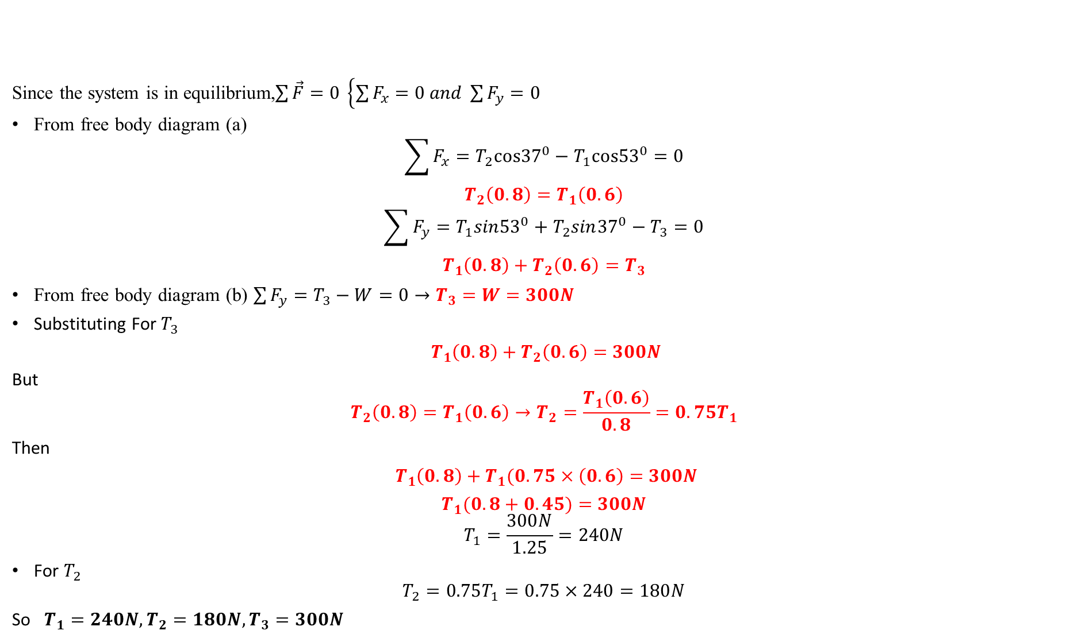
Solution
Since the system is in equilibrium,$\sum{\vec{F}=0 \left\{\sum{F_{x}=0 and \sum{F_{y}=0}}\right.}$
From free body diagram (a)
$$\sum{F_{x}=T_{2}cos{37}^{0}−T_{1}cos{53}^{0}}=0$$
$$T_{2}\left(0.8\right)=T_{1}\left(0.6\right)$$
$$\sum{F_{y}=T_{1}sin{53}^{0}+T_{2}sin{37}^{0}}−T_{3}=0$$
$$T_{1}\left(0.8\right)+T_{2}\left(0.6\right)=T_{3}$$
From free body diagram (b) $\sum{F_{y}=T_{3}−W=0}→T_{3}=W=300N$
Substituting For $T_{3}$
$T_{1}\left(0.8\right)+T_{2}\left(0.6\right)=$ $300N$
But
$$T_{2}\left(0.8\right)=T_{1}\left(0.6\right)→T_{2}=\frac{T_{1}\left(0.6\right)}{0.8}=0.75T_{1}$$
Then
$T_{1}\left(0.8\right)+T_{1}(0.75×\left(0.6\right)=$ $300N$
$T_{1}(0.8+0.45)=$ $300N$
$$T_{1}=\frac{300N}{1.25}=240N$$
For $T_{2}$
$$T_{2}=0.75T_{1}=0.75×240=180N$$
So $T_{1}=240N, T_{2}=180N, T_{3}=300N$

Slide 27
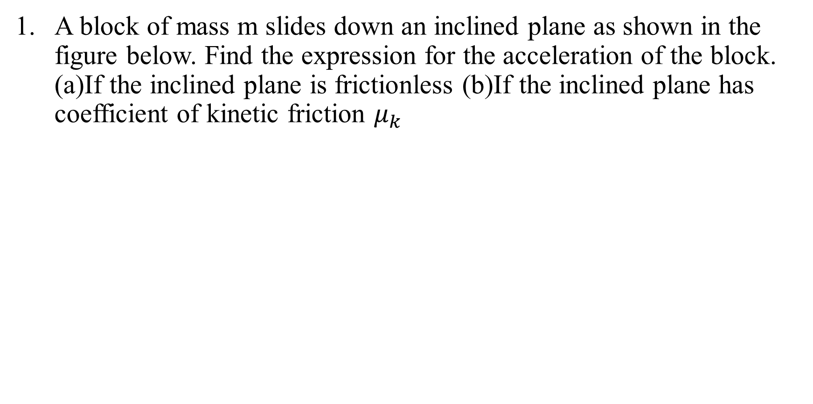

Example 2 (For $\sum{\vec{F}=m\vec{a}}$)
A block of mass m slides down an inclined plane as shown in the figure below. Find the expression for the acceleration of the block. (a)If the inclined plane is frictionless (b)If the inclined plane has coefficient of kinetic friction $μ_{k}$

Slide 28
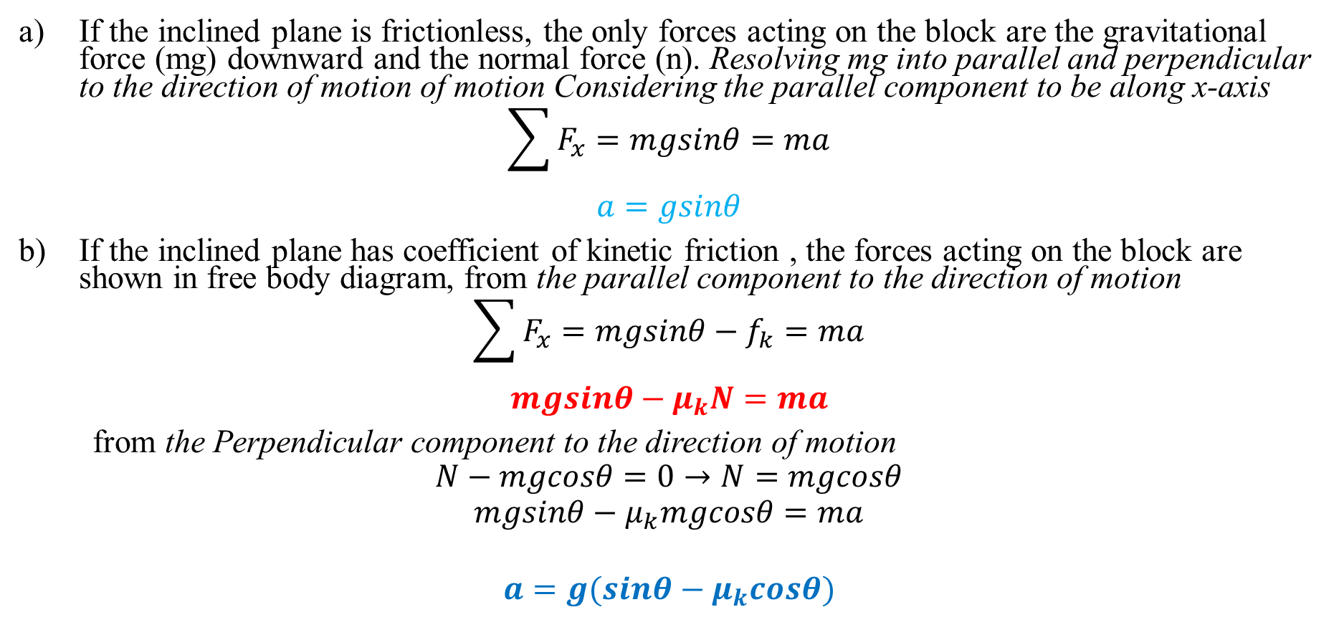
Solution
If the inclined plane is frictionless, the only forces acting on the block are the gravitational force (mg) downward and the normal force (n). Resolving mg into parallel and perpendicular to the direction of motion of motion Considering the parallel component to be along x-axis
$$\sum{F_{x}=mgsinθ=ma}$$
$$a=gsinθ$$
If the inclined plane has coefficient of kinetic friction , the forces acting on the block are shown in free body diagram, from the parallel component to the direction of motion
$$\sum{F_{x}=mgsinθ−f_{k}=ma}$$
$$mgsinθ−μ_{k}N=ma$$
from the Perpendicular component to the direction of motion
$$N−mgcosθ=0→N=mgcosθ$$
$$mgsinθ−μ_{k}mgcosθ=ma$$
$$a=g(sinθ−μ_{k}cosθ)$$

Slide 29
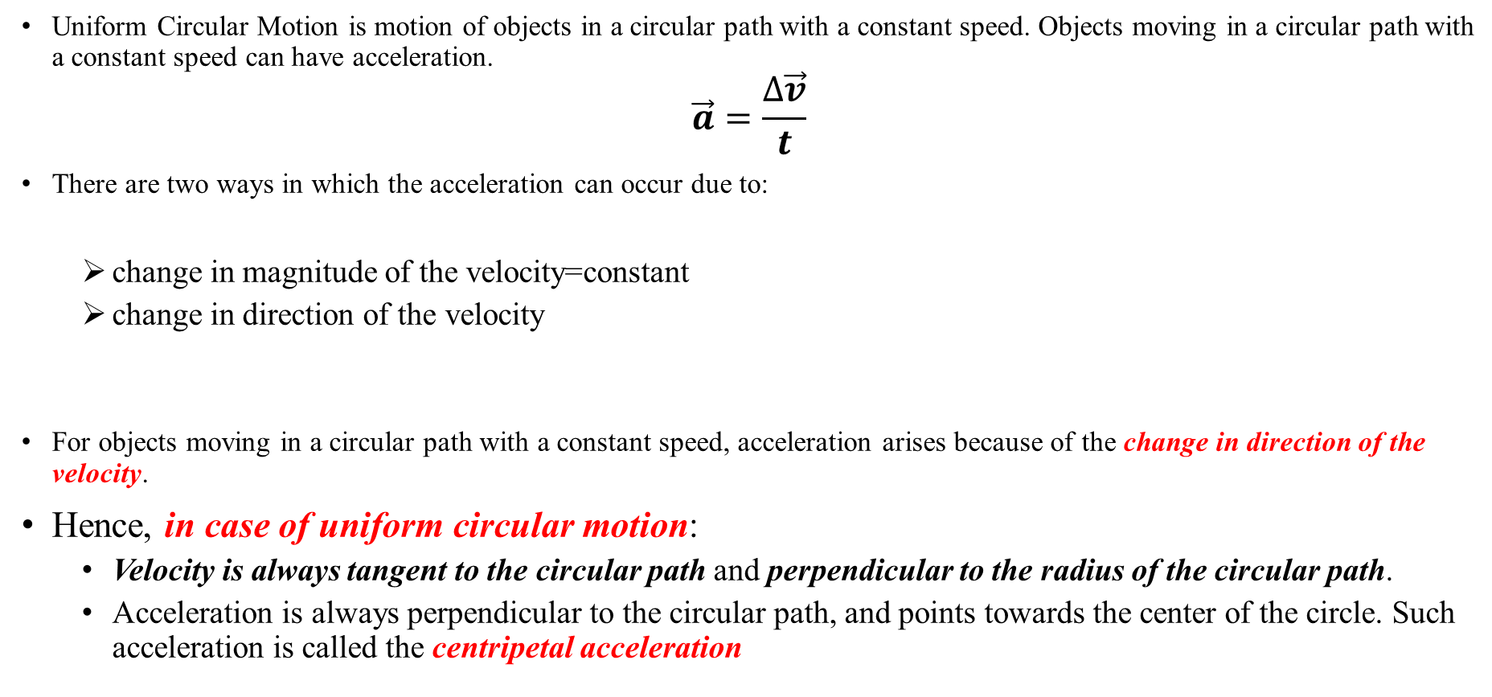
2.2.4. Uniform Circular Motion
Uniform Circular Motion is motion of objects in a circular path with a constant speed. Objects moving in a circular path with a constant speed can have acceleration.
$$\vec{a}=\frac{∆\vec{v}}{t}$$
There are two ways in which the acceleration can occur due to:
change in magnitude of the velocity=constant
change in direction of the velocity
For objects moving in a circular path with a constant speed, acceleration arises because of the change in direction of the velocity.
Hence, in case of uniform circular motion:
Velocity is always tangent to the circular path and perpendicular to the radius of the circular path.
Acceleration is always perpendicular to the circular path, and points towards the center of the circle. Such acceleration is called the centripetal acceleration

Slide 30
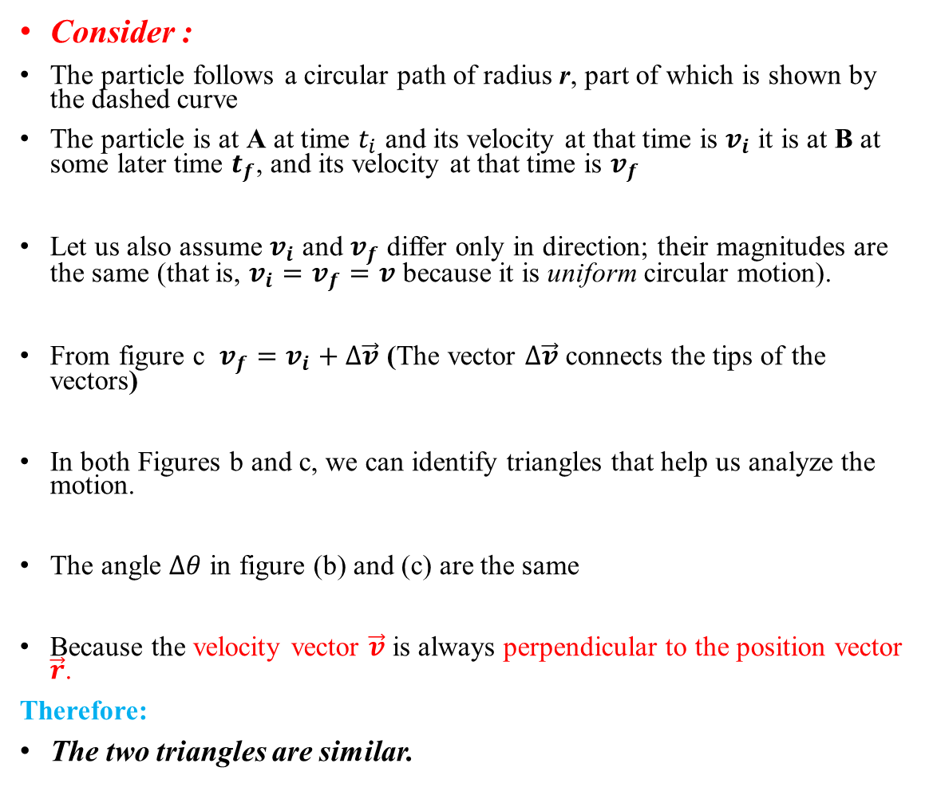
Cont…
Consider :
The particle follows a circular path of radius r, part of which is shown by the dashed curve
The particle is at A at time $t_{i}$ and its velocity at that time is $v_{i}$ it is at B at some later time $t_{f}$, and its velocity at that time is $v_{f}$
Let us also assume $v_{i}$ and $v_{f}$ differ only in direction; their magnitudes are the same (that is, $v_{i}=v_{f}=v$ because it is uniform circular motion).
From figure c $v_{f}=v_{i}+∆\vec{v}$ (The vector $∆\vec{v}$ connects the tips of the vectors)
In both Figures b and c, we can identify triangles that help us analyze the motion.
The angle $∆θ$ in figure (b) and (c) are the same
Because the velocity vector $\vec{v}$ is always perpendicular to the position vector $\vec{r}$.
Therefore:
The two triangles are similar.

Slide 31
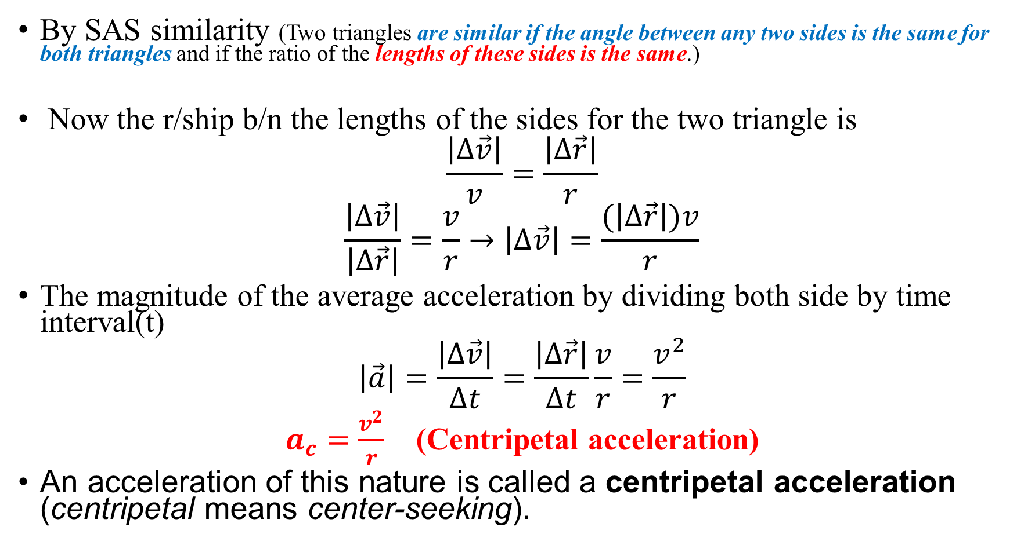
Cont….
By SAS similarity (Two triangles are similar if the angle between any two sides is the same for both triangles and if the ratio of the lengths of these sides is the same.)
Now the r/ship b/n the lengths of the sides for the two triangle is
$$\frac{\left|∆\vec{v}\right|}{v}=\frac{\left|∆\vec{r}\right|}{r}$$
$$\frac{\left|∆\vec{v}\right|}{\left|∆\vec{r}\right|}=\frac{v}{r}→\left|∆\vec{v}\right|=\frac{(\left|∆\vec{r}\right|)v}{r}$$
The magnitude of the average acceleration by dividing both side by time interval(t)
$$\left|\vec{a}\right|=\frac{\left|∆\vec{v}\right|}{∆t}=\frac{\left|∆\vec{r}\right|}{∆t}\frac{v}{r}=\frac{v^{2}}{r}$$
$a_{c}=\frac{v^{2}}{r}$ (Centripetal acceleration)
An acceleration of this nature is called a centripetal acceleration (centripetal means center-seeking).

Slide 32
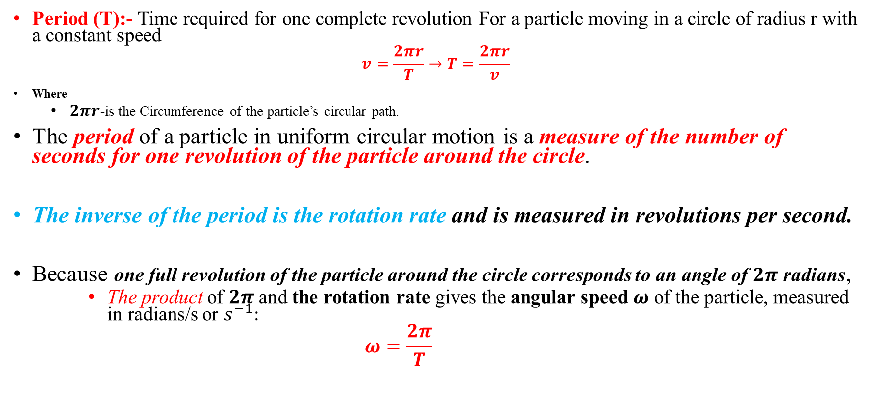
Cont…
Period (T):- Time required for one complete revolution For a particle moving in a circle of radius r with a constant speed
$$v=\frac{2πr}{T}→T=\frac{2πr}{v}$$
Where
$2πr$-is the Circumference of the particle’s circular path.
The period of a particle in uniform circular motion is a measure of the number of seconds for one revolution of the particle around the circle.
The inverse of the period is the rotation rate and is measured in revolutions per second.
Because one full revolution of the particle around the circle corresponds to an angle of $2π$ radians,
The product of $2π$ and the rotation rate gives the angular speed $ω$ of the particle, measured in radians/s or $s^{−1}$:
$$ω=\frac{2π}{T}$$

Slide 33
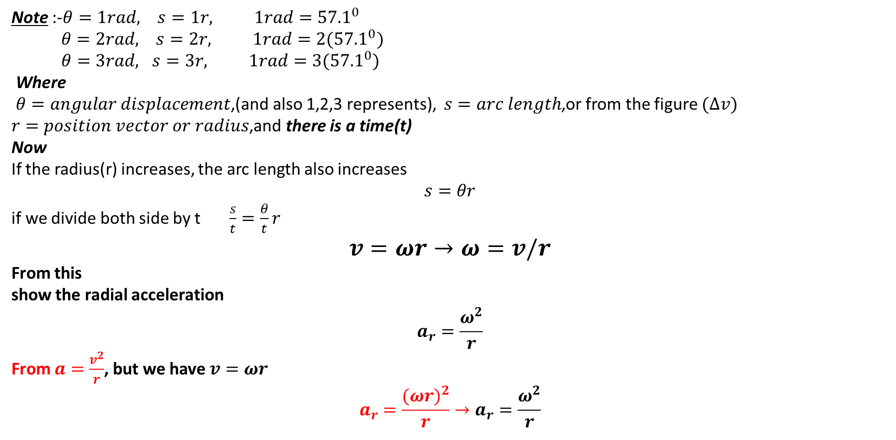
Cont…
Note :-$θ=1rad, s=1r, 1rad={57.1}^{0}$
$θ=2rad, s=2r, 1rad={2(57.1}^{0})$
$θ=3rad, s=3r, 1rad={3(57.1}^{0})$
Where
$θ=angular displacement$,(and also 1,2,3 represents), $s=arc length$,or from the figure $(∆v)$
$r=position vector or radius$,and there is a time(t)
Now
If the radius(r) increases, the arc length also increases
$$s=θr$$
if we divide both side by t $\frac{s}{t}=\frac{θ}{t}r$
$$v=ωr→ω=v/r$$
From this
show the radial acceleration
$$a_{r}=\frac{ω^{2}}{r}$$
From $a=\frac{v^{2}}{r}$, but we have $v=ωr$
$$a_{r}=\frac{{(ωr)}^{2}}{r}→a_{r}=\frac{ω^{2}}{r}$$

Slide 34
2.2.5. Newton’s Law of Universal Gravitation
Gravity is the weakest of the four basic forces found in nature, and in some ways the least understood.
Newton was the first scientist to precisely define the gravitational force, and to show that it could explain both falling bodies and astronomical motions.
But Newton was not the first person to suspect that the same force caused both our weight and the motion of planets.
His forerunner Galileo Galilei had contended that falling bodies and planetary motions had the same cause.
Some of Newton‘s contemporaries, such as
Robert Hooke,
Christopher Wren, and
Edmund Halley, had also made some progress toward understanding gravitation.
But Newton was the first to propose an exact mathematical form and to use that form to show that the motion of heavenly bodies should be conic sections; circles, ellipses, parabolas, and hyperbolas.
This theoretical prediction was a major triumph, it had been known for some time that moons, planets, and comets follow such paths, but no one had been able to propose a mechanism that caused them to follow these paths and not others.

Slide 35
Cont..
The gravitational force is always attractive, and it depends only on the masses involved and the distance between them.
Newton’s universal law of gravitation states that
“every particle in the universe attracts every other particle with a force along a line joining them”.
The force is directly proportional to the product of their masses and inversely proportional to the square of the distance between them.
Gravitational attraction is along a line joining the centers of mass of these two bodies.
The magnitude of the force is the same on each, consistent with Newton‘s third law.

Slide 36
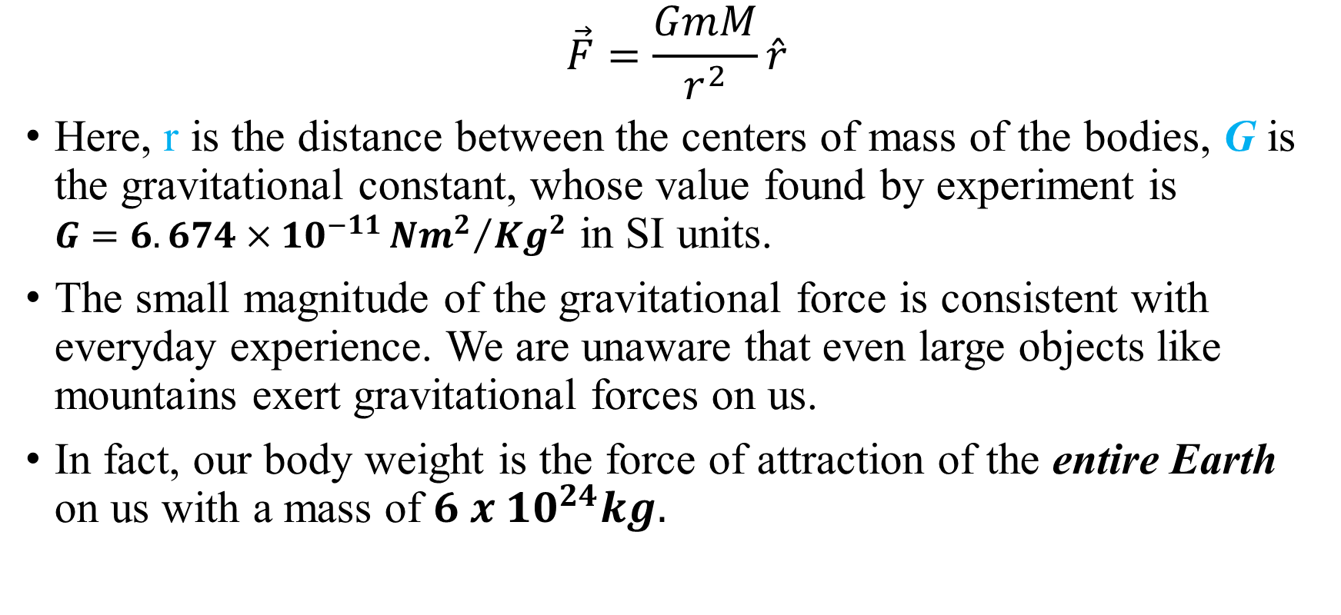
$$\vec{F}=\frac{GmM}{r^{2}}\hat{r}$$
Here, r is the distance between the centers of mass of the bodies, G is the gravitational constant, whose value found by experiment is $G=6.674×{10}^{−11}{{Nm}^{2}}/{{Kg}^{2}}$ in SI units.
The small magnitude of the gravitational force is consistent with everyday experience. We are unaware that even large objects like mountains exert gravitational forces on us.
In fact, our body weight is the force of attraction of the entire Earth on us with a mass of $6 x {10}^{24}kg.$

Slide 37
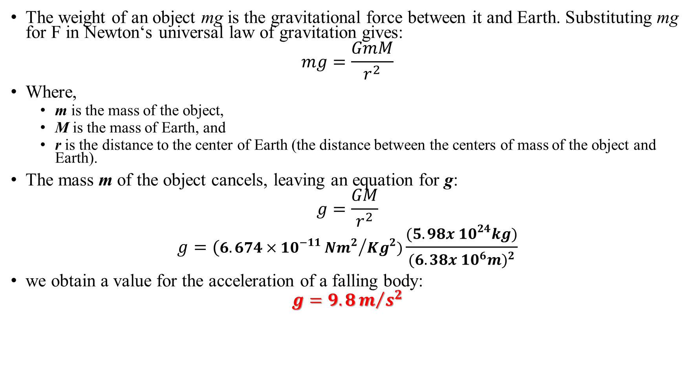
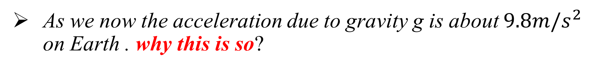
As we now the acceleration due to gravity g is about $9.8m/s^{2}$ on Earth . why this is so?
The weight of an object mg is the gravitational force between it and Earth. Substituting mg for F in Newton‘s universal law of gravitation gives:
$$mg=\frac{GmM}{r^{2}}$$
Where,
m is the mass of the object,
M is the mass of Earth, and
r is the distance to the center of Earth (the distance between the centers of mass of the object and Earth).
The mass m of the object cancels, leaving an equation for g:
$$g=\frac{GM}{r^{2}}$$
$$g=(6.674×{10}^{−11}{{Nm}^{2}}/{{Kg}^{2})\frac{(5.98x {10}^{24}kg)}{(6. 38x {10}^{6}{m)}^{2}}}$$
we obtain a value for the acceleration of a falling body:
$$g=9.8m/{s^{2}}$$

Slide 38
Cont….
This is the expected value and is independent of the body’s mass.
Newton‘s law of gravitation takes Galileo‘s observation that all masses fall with the same acceleration a step further, explaining the observation in terms of a force that causes objects to fall, in fact, in terms of a universally existing force of attraction between masses.

Slide 39
2.2.6. Kepler’s Laws, Satellites Motion and Weightlessness
The basic laws of planetary motion were established by Johannes Kepler (1571-1630) based on
the analysis of astronomical observations of Tycho Brahe (1546−1601).
In 1609, Kepler formulated the first two laws.
The third law was discovered in 1619.
Later, in the late 17th century, Isaac Newton proved mathematically that all three laws of Kepler are a consequence of the law of universal gravitation.
Kepler’s complete analysis of planetary motion is summarized in three statements known as Kepler’s laws:
All planets move in elliptical orbits with the Sun at one focus.
The radius vector drawn from the Sun to a planet sweeps out equal areas in equal time intervals.
The square of the orbital period of any planet is proportional to the cube of the semi major axis of the elliptical orbit.

Slide 40
Kepler’s First Law (Law of Orbits)
States that
The orbit of each planet in the solar system is an ellipse, the Sun will be on one focus.
The points F1 and F2 represented in figure 1 are known as the foci of the ellipse.
The closer together that these points are, the more closely that the ellipse resembles the shape of a circle.
In fact, a circle is the special case of an ellipse in which the two foci are at the same location.
Kepler's first law is rather simple - all planets orbit the sun in a path that resembles an ellipse, with the sun being located at one of the foci of that ellipse.

Slide 41
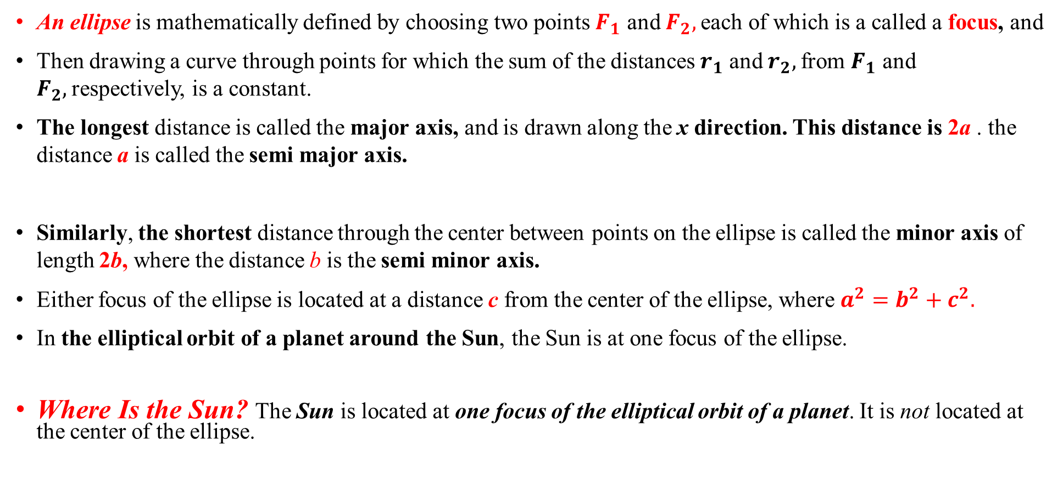
Ellipse
An ellipse is mathematically defined by choosing two points $F_{1}$ and $F_{2},$each of which is a called a focus, and
Then drawing a curve through points for which the sum of the distances $r_{1}$ and $r_{2},$from $F_{1}$ and $F_{2},$respectively, is a constant.
The longest distance is called the major axis, and is drawn along the x direction. This distance is 2a . the distance a is called the semi major axis.
Similarly, the shortest distance through the center between points on the ellipse is called the minor axis of length 2b, where the distance b is the semi minor axis.
Either focus of the ellipse is located at a distance c from the center of the ellipse, where $a^{2}=b^{2}+c^{2}.$
In the elliptical orbit of a planet around the Sun, the Sun is at one focus of the ellipse.
Where Is the Sun? The Sun is located at one focus of the elliptical orbit of a planet. It is not located at the center of the ellipse.

Slide 42
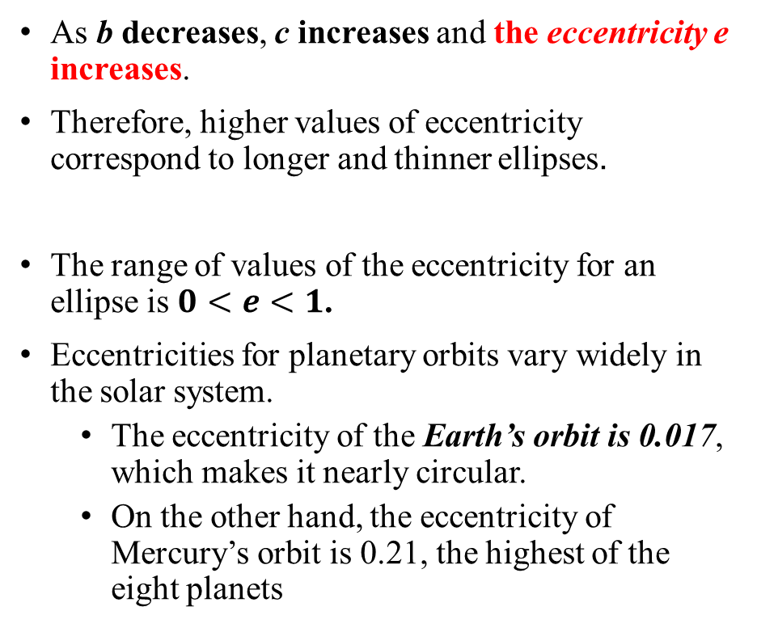
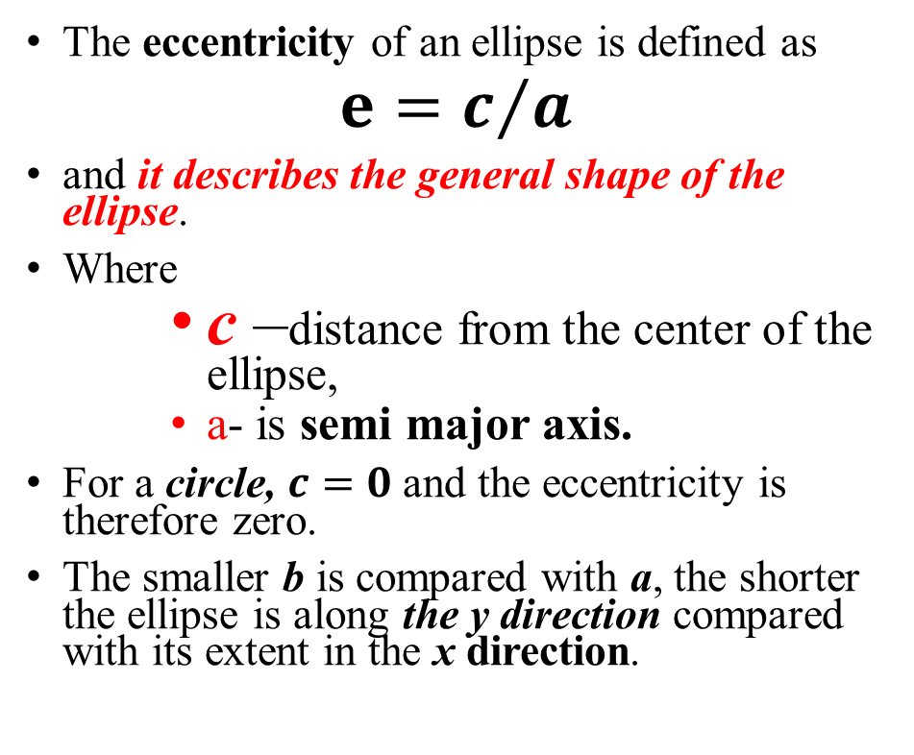
Eccentricity
The eccentricity of an ellipse is defined as
$e=c/a$
and it describes the general shape of the ellipse.
Where
c –distance from the center of the ellipse,
a- is semi major axis.
For a circle, $c=0$and the eccentricity is therefore zero.
The smaller b is compared with a, the shorter the ellipse is along the y direction compared with its extent in the x direction.
As b decreases, c increases and the eccentricity e increases.
Therefore, higher values of eccentricity correspond to longer and thinner ellipses.
The range of values of the eccentricity for an ellipse is $0<e<1$.
Eccentricities for planetary orbits vary widely in the solar system.
The eccentricity of the Earth’s orbit is 0.017, which makes it nearly circular.
On the other hand, the eccentricity of Mercury’s orbit is 0.21, the highest of the eight planets

Slide 43
Kepler’s Second Law (The Law of Areas)
States that ―
The radius vector connecting the centers of the Sun and the Planet sweeps out equal areas in equal intervals of time.
The Figure below shows the two sectors of the ellipse having equal areas corresponding to the same time intervals.

Slide 44
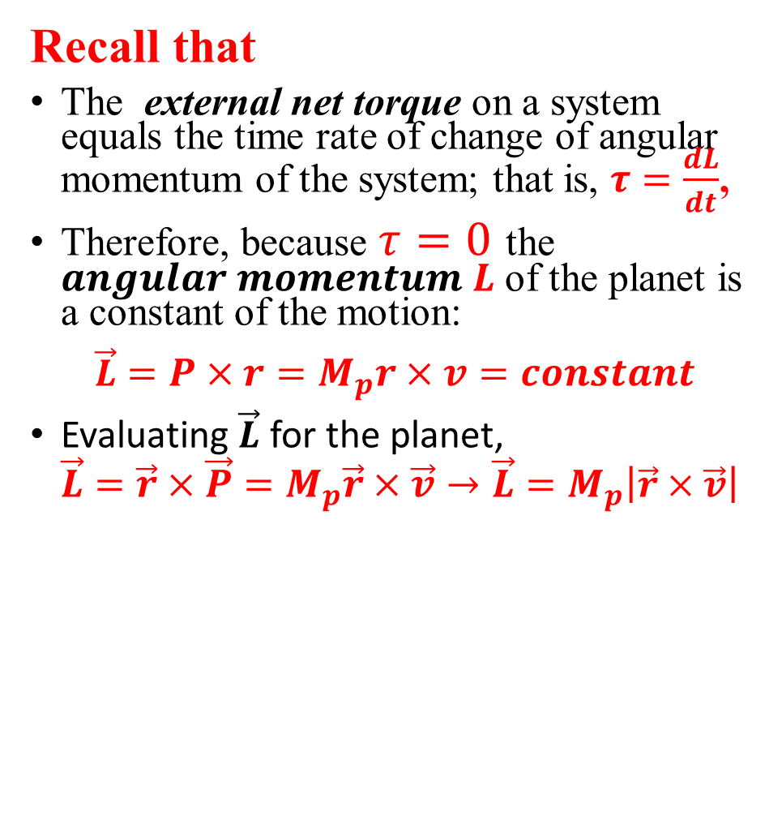
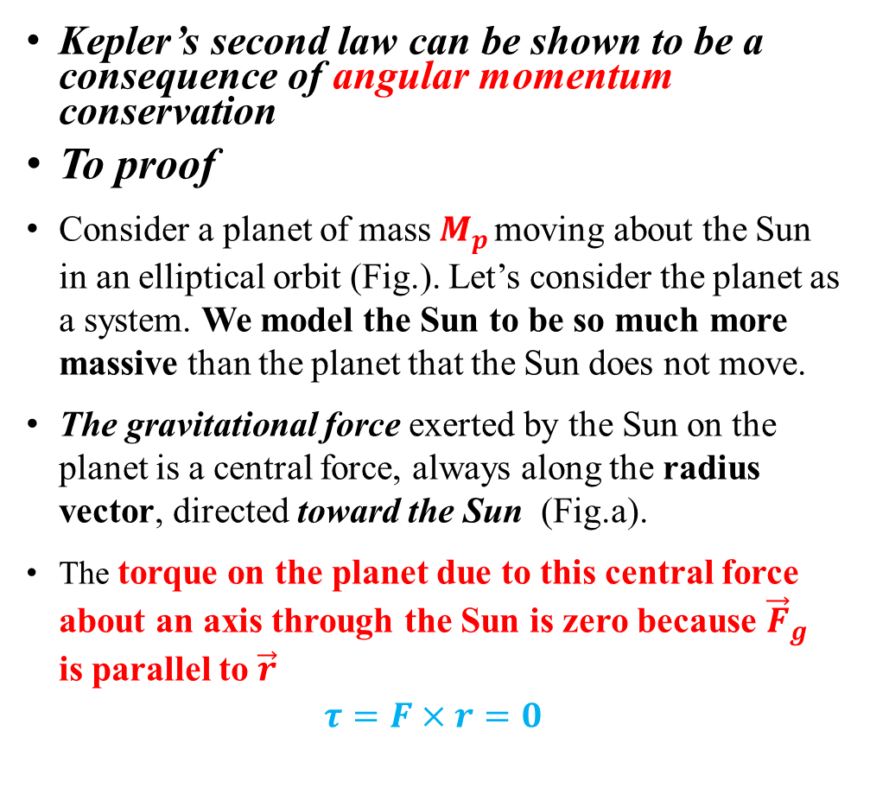
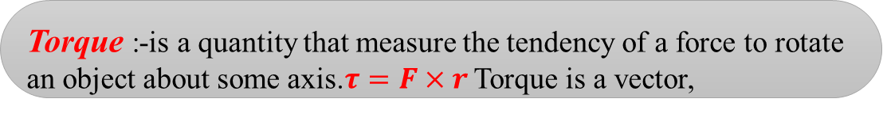
Kepler’s second law can be shown to be a consequence of angular momentum conservation
To proof
Consider a planet of mass $M_{p}$ moving about the Sun in an elliptical orbit (Fig.). Let’s consider the planet as a system. We model the Sun to be so much more massive than the planet that the Sun does not move.
The gravitational force exerted by the Sun on the planet is a central force, always along the radius vector, directed toward the Sun (Fig.a).
The torque on the planet due to this central force about an axis through the Sun is zero because ${\vec{F}}_{g}$ is parallel to $\vec{r}$
$$τ=F×r=0$$
Recall that
The external net torque on a system equals the time rate of change of angular momentum of the system; that is, $τ=\frac{dL}{dt}$,
Therefore, because $τ=0$ the $angular momentum L$of the planet is a constant of the motion:
$$\vec{L}=P×r=M_{p}r×v=constant$$
Evaluating $\vec{L}$ for the planet,
$$\vec{L}=\vec{r}×\vec{P}=M_{p}\vec{r}×\vec{v}→\vec{L}=M_{p}\left|\vec{r}×\vec{v}\right|$$
Torque :-is a quantity that measure the tendency of a force to rotate an object about some axis.$τ=F×r$ Torque is a vector,

Slide 45
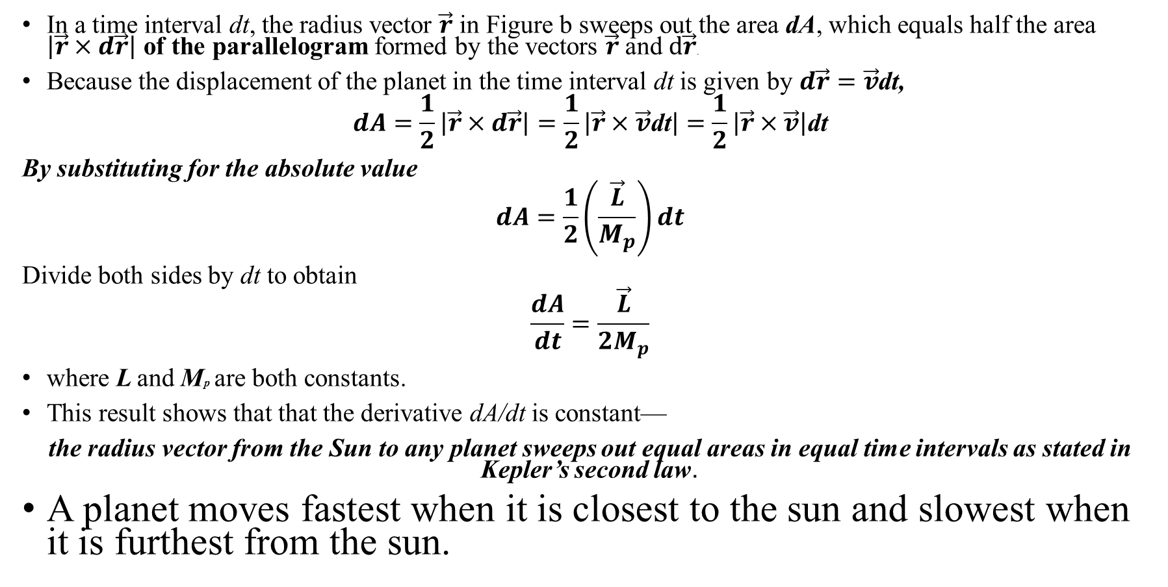
Cont…
In a time interval dt, the radius vector $\vec{r}$ in Figure b sweeps out the area dA, which equals half the area $\left|\vec{r}×d\vec{r}\right|$ of the parallelogram formed by the vectors $\vec{r}$ and $d\vec{r}$.
Because the displacement of the planet in the time interval dt is given by $d\vec{r}=\vec{v}$dt,
$$dA=\frac{1}{2}\left|\vec{r}×d\vec{r}\right|=\frac{1}{2}\left|\vec{r}×\vec{v}\text{dt}\right|=\frac{1}{2}\left|\vec{r}×\vec{v}\right|\text{dt}$$
By substituting for the absolute value
$$dA=\frac{1}{2}\left(\frac{\vec{L}}{M_{p}}\right)dt$$
Divide both sides by dt to obtain
$$\frac{dA}{dt}=\frac{\vec{L}}{{2M}_{p}}$$
where L and Mp are both constants.
This result shows that that the derivative dA/dt is constant—
the radius vector from the Sun to any planet sweeps out equal areas in equal time intervals as stated in Kepler’s second law.
A planet moves fastest when it is closest to the sun and slowest when it is furthest from the sun.

Slide 46
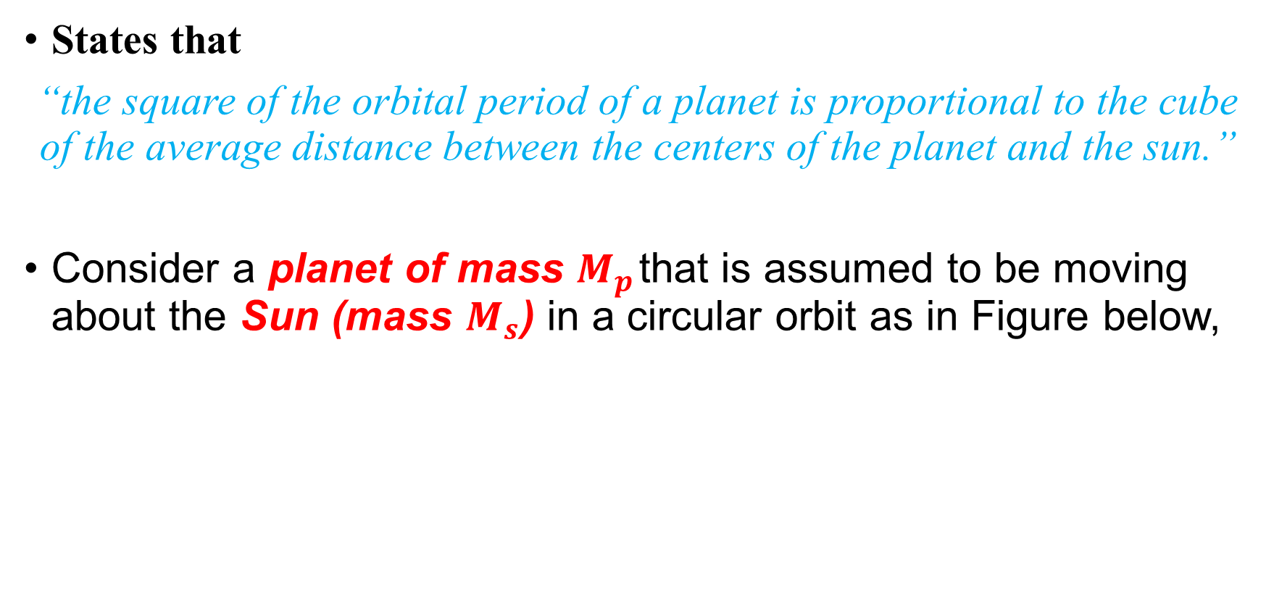
Kepler’s Third Law (The Law of Harmony)
States that
“the square of the orbital period of a planet is proportional to the cube of the average distance between the centers of the planet and the sun.”
Consider a planet of mass $M_{p}$ that is assumed to be moving about the Sun (mass $M_{s}$) in a circular orbit as in Figure below,

Slide 47
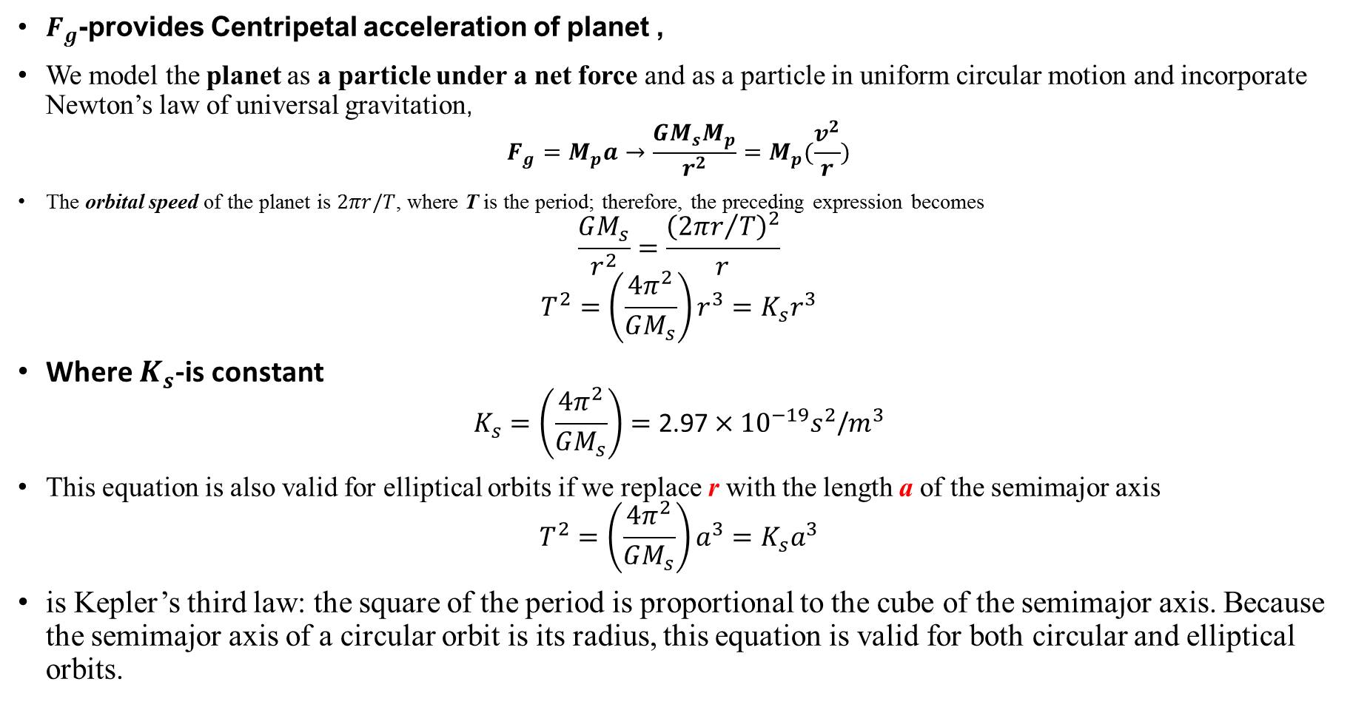
$F_{g}$-provides Centripetal acceleration of planet ,
We model the planet as a particle under a net force and as a particle in uniform circular motion and incorporate Newton’s law of universal gravitation,
$$F_{g}=M_{p}a→\frac{GM_{s}M_{p}}{r^{2}}=M_{p}(\frac{v^{2}}{r})$$
The orbital speed of the planet is $2πr/T$, where T is the period; therefore, the preceding expression becomes
$$\frac{GM_{s}}{r^{2}}=\frac{{\left({2πr}/T\right)}^{2}}{r}$$
$$T^{2}=\left(\frac{4π^{2}}{GM_{s}}\right)r^{3}=K_{s}r^{3}$$
Where $K_{s}$-is constant
$$K_{s}=\left(\frac{4π^{2}}{GM_{s}}\right)=\text{2.97}×{10}^{−19}s^{2}\text{/}m^{3}$$
This equation is also valid for elliptical orbits if we replace r with the length a of the semimajor axis
$$T^{2}=\left(\frac{4π^{2}}{GM_{s}}\right)a^{3}=K_{s}a^{3}$$
is Kepler’s third law: the square of the period is proportional to the cube of the semimajor axis. Because the semimajor axis of a circular orbit is its radius, this equation is valid for both circular and elliptical orbits.

Slide 48
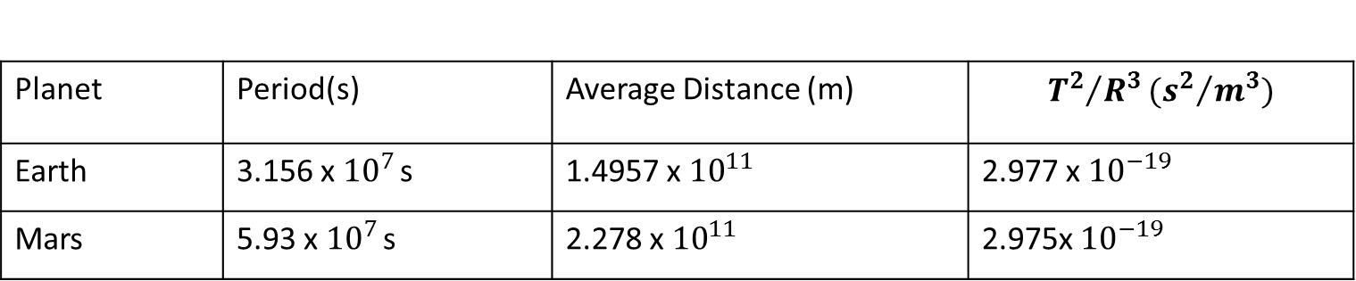
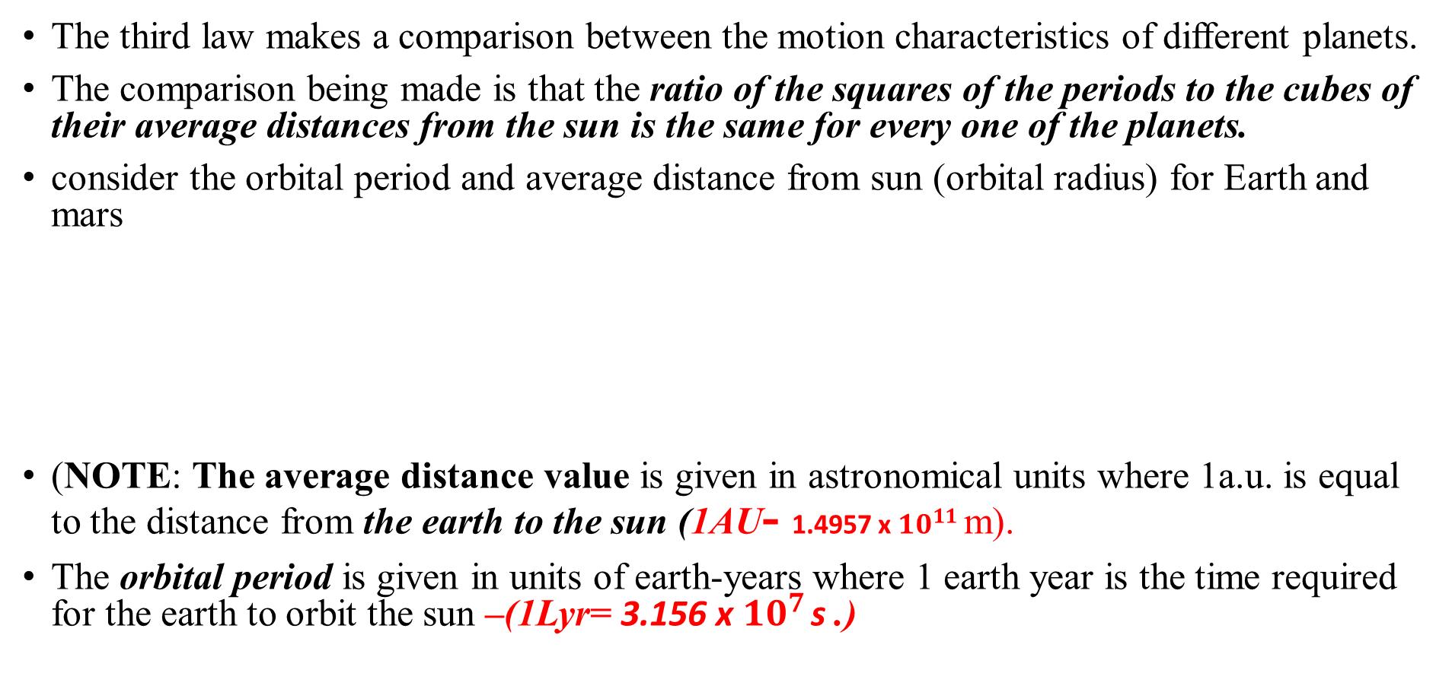
Generally Kepler's 3rd Law
The third law makes a comparison between the motion characteristics of different planets.
The comparison being made is that the ratio of the squares of the periods to the cubes of their average distances from the sun is the same for every one of the planets.
consider the orbital period and average distance from sun (orbital radius) for Earth and mars
(NOTE: The average distance value is given in astronomical units where 1a.u. is equal to the distance from the earth to the sun (1AU- 1.4957 x ${10}^{11}$m).
The orbital period is given in units of earth-years where 1 earth year is the time required for the earth to orbit the sun –(1Lyr= 3.156 x ${10}^{7}$ s .)
Planet | Period(s) | Average Distance (m) | $${T^{2}}/{R^{3}}({s^{2}}/{m^{3}})$$
Earth | 3.156 x ${10}^{7}$ s | 1.4957 x ${10}^{11}$ | 2.977 x ${10}^{−19}$
Mars | 5.93 x ${10}^{7}$ s | 2.278 x ${10}^{11}$ | 2.975x ${10}^{−19}$

Slide 49
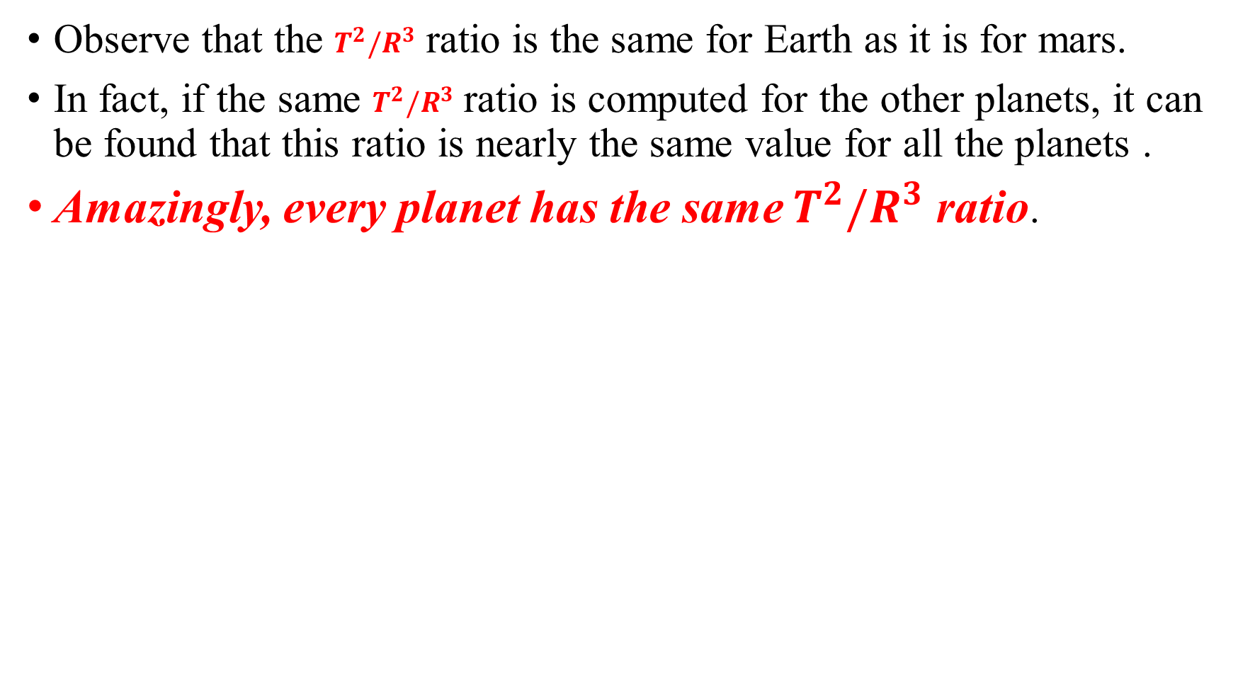
Observe that the $T^{2}/R^{3}$ ratio is the same for Earth as it is for mars.
In fact, if the same $T^{2}/R^{3}$ ratio is computed for the other planets, it can be found that this ratio is nearly the same value for all the planets .
Amazingly, every planet has the same $T^{2}/R^{3}$ ratio.
Planets | Period(yr) | Average distance(au) | (yr2/au3)
Mercury | 0.241 | 0.39 | 0.98
Venus | 0.615 | 0.72 | 1.01
Earth | 1.00 | 1.00 | 1.00
Mars | 1.88 | 1.52 | 1.01
Jupiter | 11.8 | 5.20 | 0.99
Saturn | 29.5 | 9.54 | 1.00
Uranus | 84.0 | 19.18 | 1.00
Neptune | 165 | 30.06 | 1.00
Pluto | 248 | 39.44 | 1.00

Slide 50
Satellite motion and Weightlessness
Astronauts on the orbiting space station are weightless because:
There is no gravity in space and they do not weigh anything.
Space is a vacuum and there is no gravity in a vacuum.
Space is a vacuum and there is no air resistance in a vacuum.
The astronauts are far from Earth's surface at a location where gravitation has a minimal effect.
Astronauts who are orbiting the Earth often experience sensations of weightlessness. These sensations experienced by orbiting astronauts are the same sensations experienced by anyone who has been temporarily suspended above the seat on an amusement park ride. Not only are the

Slide 51
The cause of weightlessness is quite simple to understand.
Weightlessness is simply a sensation experienced by an individual when there are no external objects touching one's body and exerting a push or pull upon it.
Weightless sensations exist when all contact forces are removed.
These sensations are common to any situation in which you are momentarily (or perpetually) in a state of free fall.
When in free fall, the only force acting upon your body is the force of gravity, a non-contact force.
Since the force of gravity cannot be felt without any other opposing forces, you would have no sensation of it.
You would feel weightless when in a state of free fall.

Slide 52
2.3. Work, Energy and Linear Momentum

Slide 53
Concept of Work…
On a typical day,
you probably wake up,
get dressed,
eat breakfast, and
head off to class or work.
After you spend all day at your job, you go home,
Eat dinner,
May be reading or studying, and
Then go to bed. In this sense, work can be just about anything
Construction ,
Typing on a keyboard,
Driving a bus,
Teaching a class,
Cooking food,
Treating patients, and so much more.

Slide 54
But in physics, work is more specific
This is the displacement of an object due to force.
How much work is done depends on the distance the object is moved.
Work can be defined as transfer of energy due to an applied force.
In physics we say that work is done on an object when energy is transferred to that object.
If one object transfers (gives) energy to a second object, then the first object does work on the second object.
The energy of a moving object is called kinetic energy.

Slide 55
Work and Energy
In physics, work is done when a force acts on an object that undergoes a displacement from one position to another.
Forces can vary as a function of position, and displacements can be along various paths between two points.
If no displacement takes place, no work is said to be done. Therefore for work to be done on an object, three essential conditions should be satisfied:
Force must be exerted on the object
The force must cause a motion or displacement
The force should have a component along the line of displacement

Slide 56
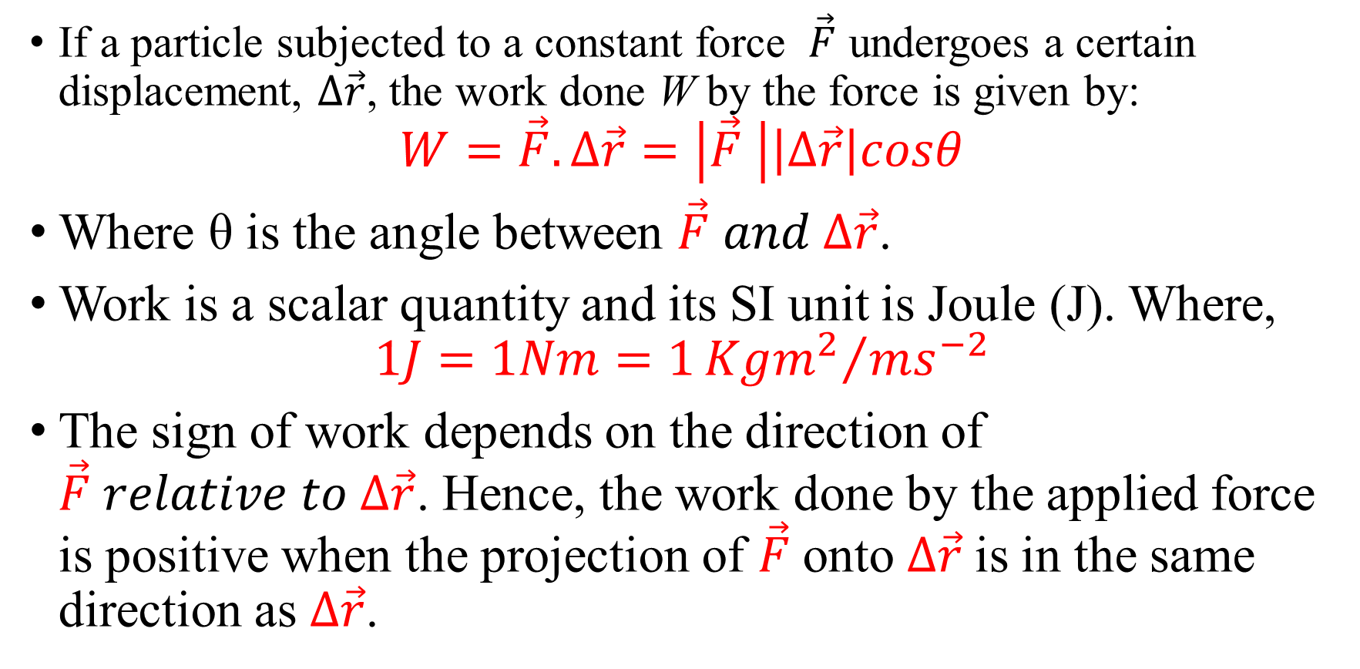
If a particle subjected to a constant force $\vec{F}$ undergoes a certain displacement, $∆\vec{r}$, the work done W by the force is given by:
$$W=\vec{F}.∆\vec{r}=\left|\vec{F} \right|\left|∆\vec{r}\right|cosθ$$
Where θ is the angle between $\vec{F} and ∆\vec{r}$.
Work is a scalar quantity and its SI unit is Joule (J). Where,
$$1J=1Nm=1{Kgm^{2}}/{ms^{−2}}$$
The sign of work depends on the direction of $\vec{F} relative to ∆\vec{r}$. Hence, the work done by the applied force is positive when the projection of $\vec{F}$onto $∆\vec{r}$ is in the same direction as $∆\vec{r}$.

Slide 57
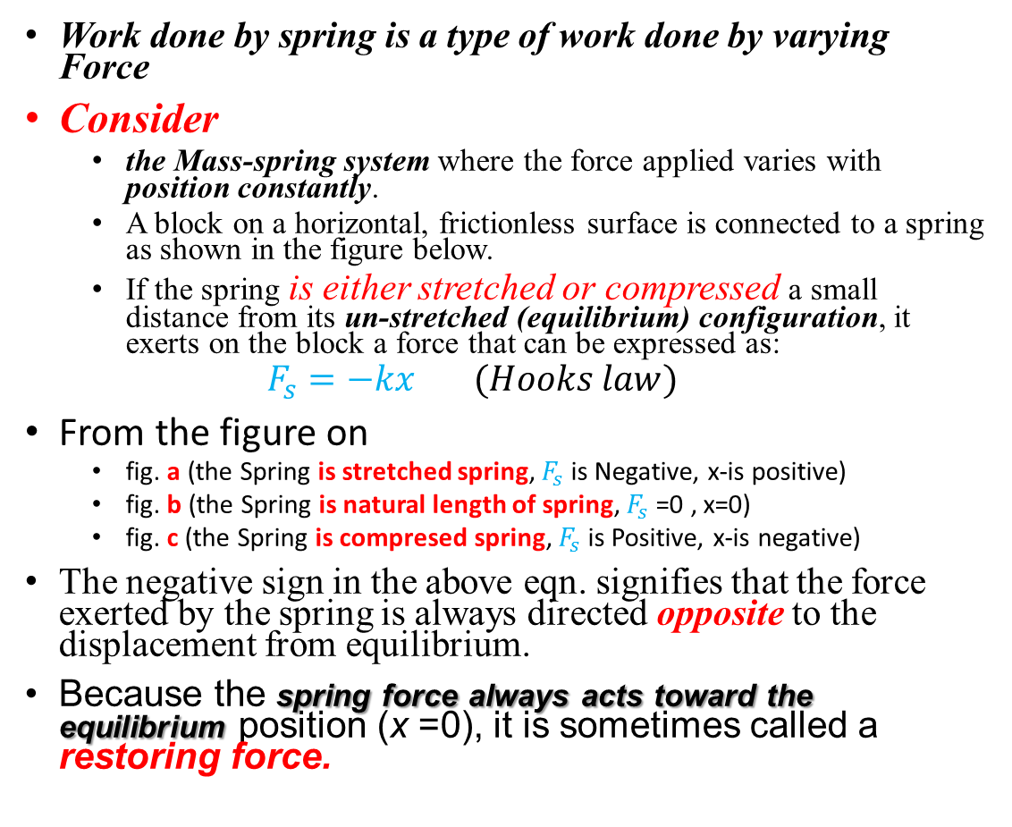
Work done by a Spring
Work done by spring is a type of work done by varying Force
Consider
the Mass-spring system where the force applied varies with position constantly.
A block on a horizontal, frictionless surface is connected to a spring as shown in the figure below.
If the spring is either stretched or compressed a small distance from its un-stretched (equilibrium) configuration, it exerts on the block a force that can be expressed as:
$$F_{s}=−kx (Hooks law)$$
From the figure on
fig. a (the Spring is stretched spring, $F_{s}$ is Negative, x-is positive)
fig. b (the Spring is natural length of spring, $F_{s}$ =0 , x=0)
fig. c (the Spring is compresed spring, $F_{s}$ is Positive, x-is negative)
The negative sign in the above eqn. signifies that the force exerted by the spring is always directed opposite to the displacement from equilibrium.
Because the spring force always acts toward the equilibrium position (x =0), it is sometimes called a restoring force.

Slide 58
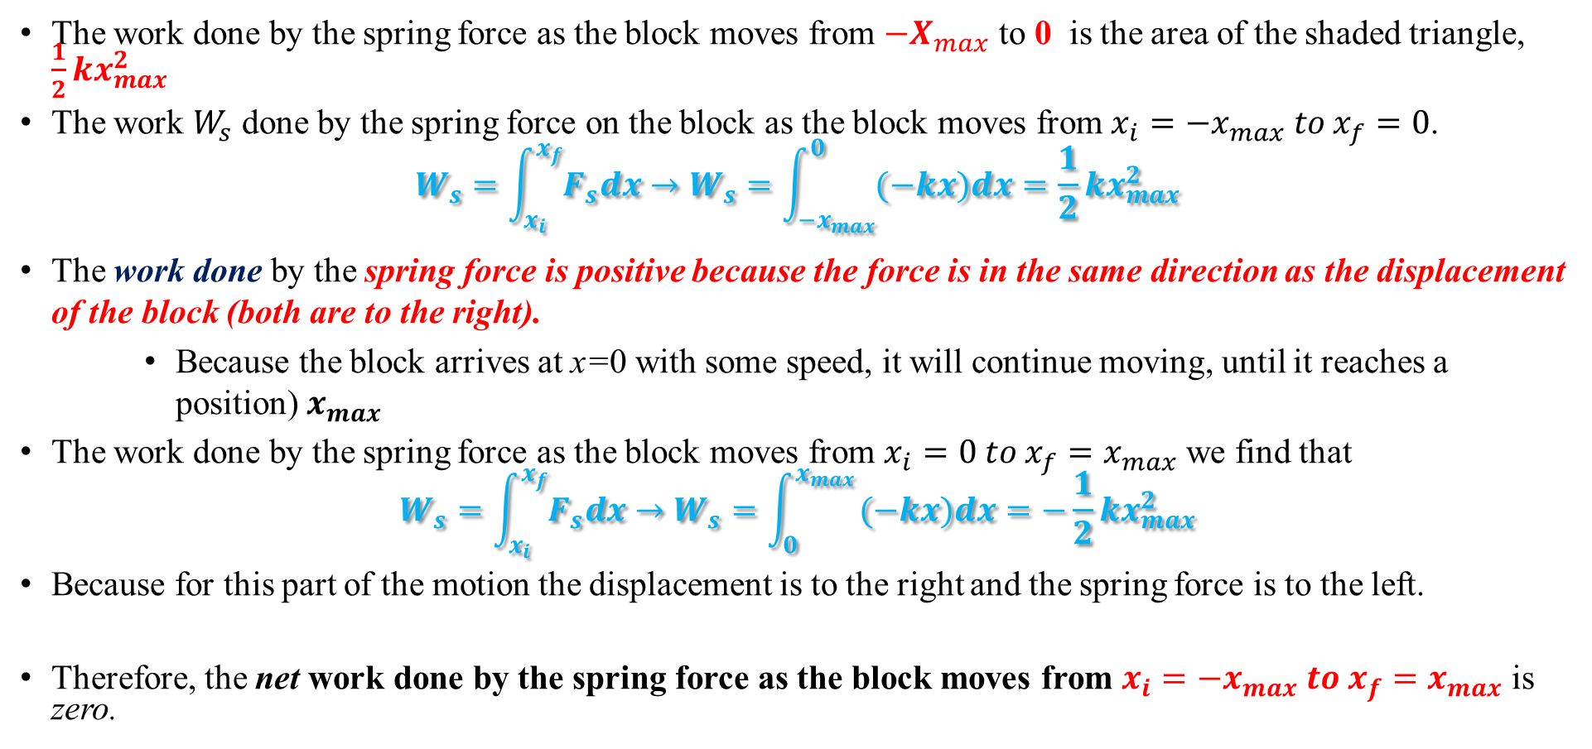

Work Done by $F_{s}$
The work done by the spring force as the block moves from $−X_{max}$ to 0 is the area of the shaded triangle, $\frac{1}{2}kx_{max}^{2}$
The work $W_{s}$ done by the spring force on the block as the block moves from$x_{i}=−x_{max} to x_{f}=0$.
$$W_{s}=\int_{x_{i}}^{x_{f}}{F_{s}dx}→W_{s}=\int_{{−x}_{max}}^{0}{(−kx)dx}=\frac{1}{2}kx_{max}^{2}$$
The work done by the spring force is positive because the force is in the same direction as the displacement of the block (both are to the right).
Because the block arrives at x=0 with some speed, it will continue moving, until it reaches a position) $x_{max}$
The work done by the spring force as the block moves from $x_{i}=0 to x_{f}=x_{max}$ we find that
$$W_{s}=\int_{x_{i}}^{x_{f}}{F_{s}dx}→W_{s}=\int_{0}^{x_{max }}{(−kx)dx}=−\frac{1}{2}kx_{max}^{2}$$
Because for this part of the motion the displacement is to the right and the spring force is to the left.
Therefore, the net work done by the spring force as the block moves from $x_{i}=−x_{max} to x_{f}=x_{max}$ is zero.

Slide 59
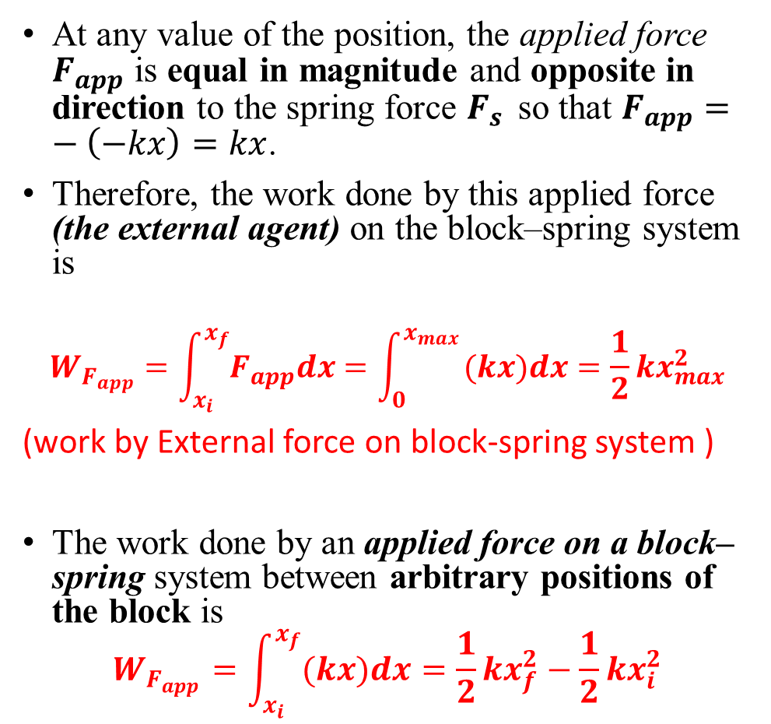
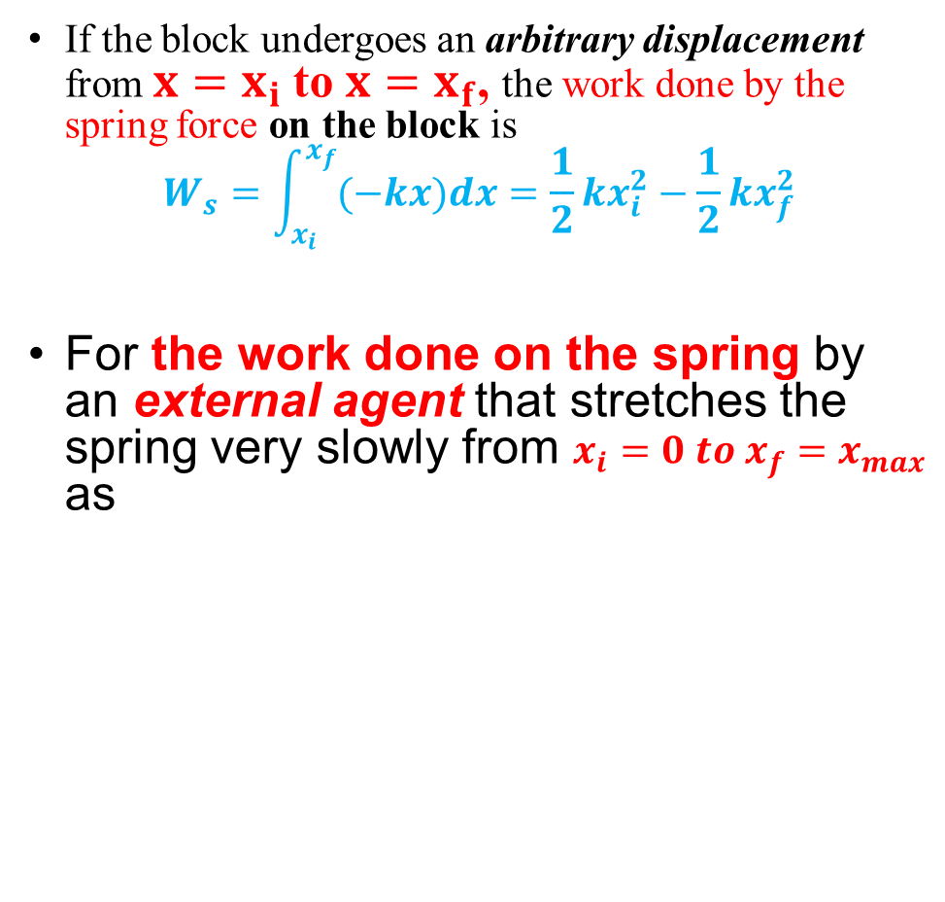
If the block undergoes an arbitrary displacement from $x=x_{i}$to $x=x_{f}$, the work done by the spring force on the block is
$$W_{s}=\int_{x_{i}}^{x_{f}}{(−kx)dx}=\frac{1}{2}kx_{i}^{2}−\frac{1}{2}kx_{f}^{2}$$
For the work done on the spring by an external agent that stretches the spring very slowly from $x_{i}=0 to x_{f}=x_{max}$ as
At any value of the position, the applied force $F_{app}$ is equal in magnitude and opposite in direction to the spring force $F_{s }$ so that $F_{app}=−\left(−kx\right)=kx$.
Therefore, the work done by this applied force (the external agent) on the block–spring system is
$$W_{F_{app}}=\int_{x_{i}}^{x_{f}}{F_{app}dx}=\int_{0}^{x_{max }}{(kx)dx}=\frac{1}{2}kx_{max}^{2}$$
(work by External force on block-spring system )
The work done by an applied force on a block–spring system between arbitrary positions of the block is
$$W_{F_{app}}=\int_{x_{i}}^{x_{f}}{(kx)dx}=\frac{1}{2}kx_{f}^{2}−\frac{1}{2}kx_{i}^{2}$$

Slide 60
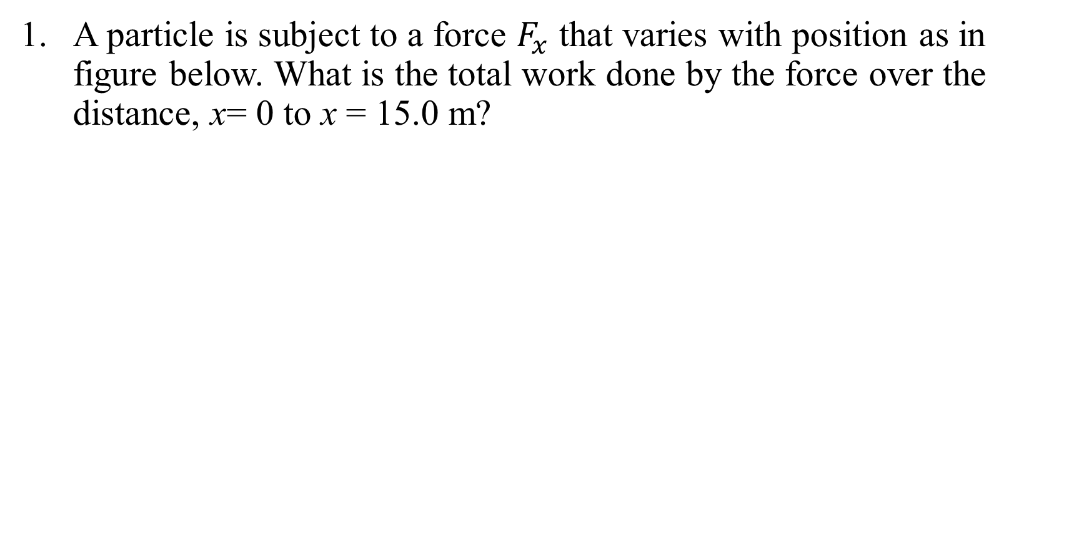
Example
A particle is subject to a force $F_{x}$ that varies with position as in figure below. What is the total work done by the force over the distance, x= 0 to x = 15.0 m?

Slide 61
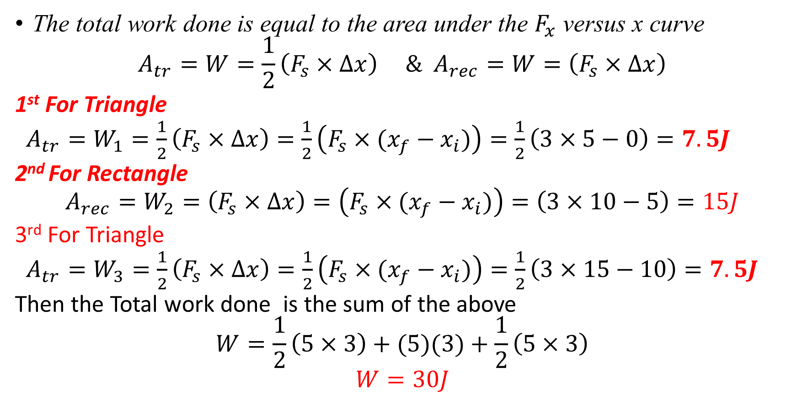
Solution
The total work done is equal to the area under the $F_{x}$ versus x curve
$$A_{tr}=W=\frac{1}{2}\left(F_{s}×∆x\right) \& A_{rec}=W=\left(F_{s}×∆x\right)$$
1st For Triangle
$A_{tr}=W_{1}=\frac{1}{2}\left(F_{s}×∆x\right)=\frac{1}{2}\left(F_{s}×(x_{f}−x_{i})\right)=\frac{1}{2}\left(3×5−0\right)=7.5J$
2nd For Rectangle
$$A_{rec}=W_{2}=\left(F_{s}×∆x\right)=\left(F_{s}×(x_{f}−x_{i})\right)=\left(3×10−5\right)=15J$$
3rd For Triangle
$A_{tr}=W_{3}=\frac{1}{2}\left(F_{s}×∆x\right)=\frac{1}{2}\left(F_{s}×(x_{f}−x_{i})\right)=\frac{1}{2}\left(3×15−10\right)=7.5J$
Then the Total work done is the sum of the above
$$W=\frac{1}{2}\left(5×3\right)+(5)(3)+\frac{1}{2}\left(5×3\right)$$
$$W=30J$$

Slide 62
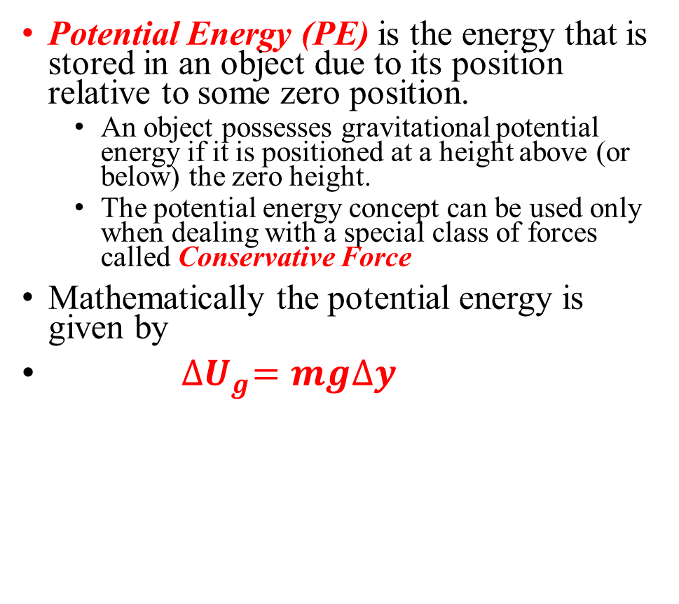
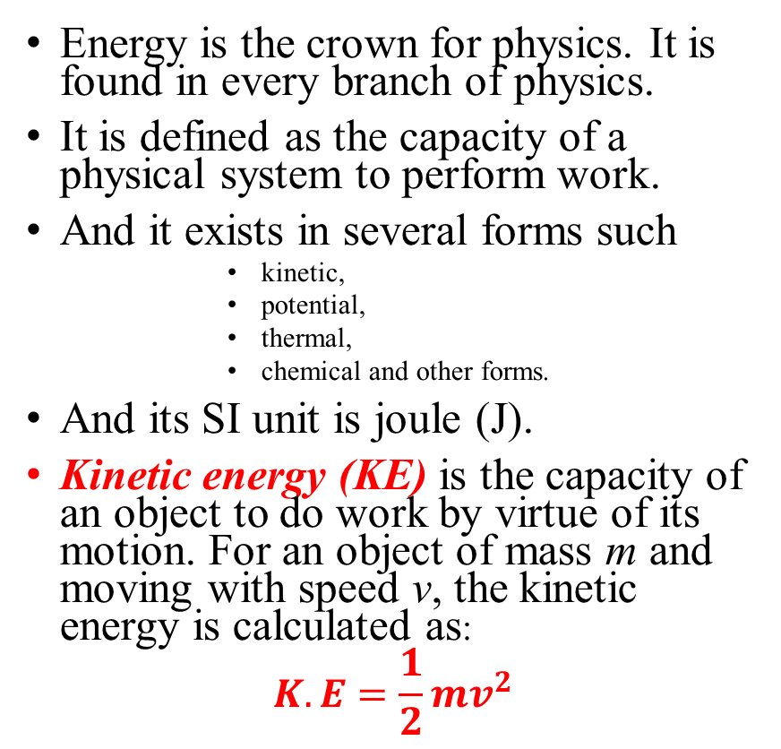
Energy
Potential Energy (PE) is the energy that is stored in an object due to its position relative to some zero position.
An object possesses gravitational potential energy if it is positioned at a height above (or below) the zero height.
The potential energy concept can be used only when dealing with a special class of forces called Conservative Force
Mathematically the potential energy is given by
${∆U}_{g}=mg∆y$
Energy is the crown for physics. It is found in every branch of physics.
It is defined as the capacity of a physical system to perform work.
And it exists in several forms such
kinetic,
potential,
thermal,
chemical and other forms.
And its SI unit is joule (J).
Kinetic energy (KE) is the capacity of an object to do work by virtue of its motion. For an object of mass m and moving with speed v, the kinetic energy is calculated as:
$$K.E=\frac{1}{2}mv^{2}$$
This equation is valid only for objects near the surface of the Earth, where g is approximately constant

Slide 63
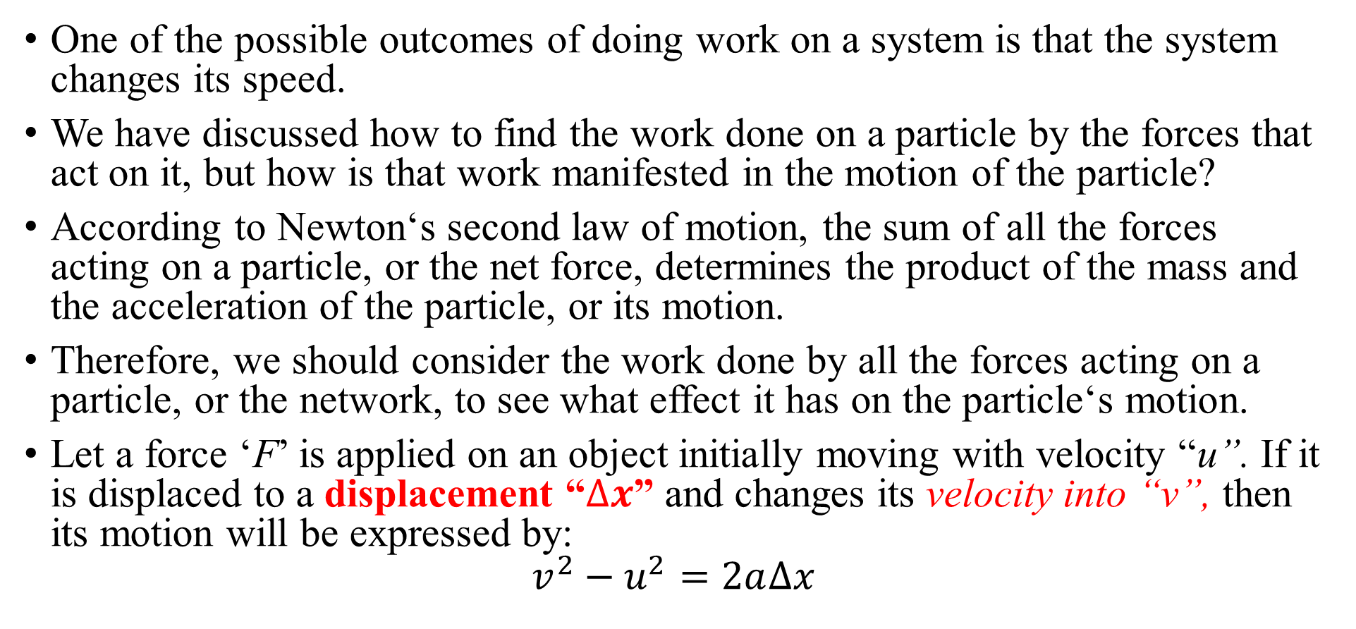
Work- Energy theorem
One of the possible outcomes of doing work on a system is that the system changes its speed.
We have discussed how to find the work done on a particle by the forces that act on it, but how is that work manifested in the motion of the particle?
According to Newton‘s second law of motion, the sum of all the forces acting on a particle, or the net force, determines the product of the mass and the acceleration of the particle, or its motion.
Therefore, we should consider the work done by all the forces acting on a particle, or the network, to see what effect it has on the particle‘s motion.
Let a force ‘F’ is applied on an object initially moving with velocity “u”. If it is displaced to a displacement “$∆x$” and changes its velocity into “v”, then its motion will be expressed by:
$$v^{2}−u^{2}=2a∆x$$

Slide 64
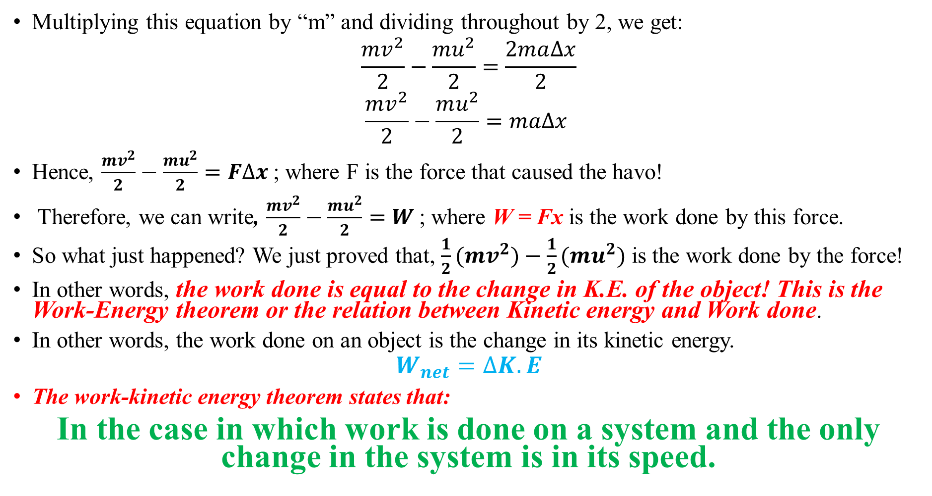
Multiplying this equation by “m” and dividing throughout by 2, we get:
$$\frac{mv^{2}}{2}−\frac{mu^{2}}{2}=\frac{2ma∆x}{2}$$
$$\frac{mv^{2}}{2}−\frac{mu^{2}}{2}=ma∆x$$
Hence, $\frac{mv^{2}}{2}−\frac{mu^{2}}{2}=F∆x$ ; where F is the force that caused the havo!
Therefore, we can write, $\frac{mv^{2}}{2}−\frac{mu^{2}}{2}=W$ ; where W = Fx is the work done by this force.
So what just happened? We just proved that, $\frac{1}{2}(mv^{2})−\frac{1}{2}(mu^{2})$ is the work done by the force!
In other words, the work done is equal to the change in K.E. of the object! This is the Work-Energy theorem or the relation between Kinetic energy and Work done.
In other words, the work done on an object is the change in its kinetic energy.
$$W_{net}=∆K.E$$
The work-kinetic energy theorem states that:
In the case in which work is done on a system and the only change in the system is in its speed.

Slide 65
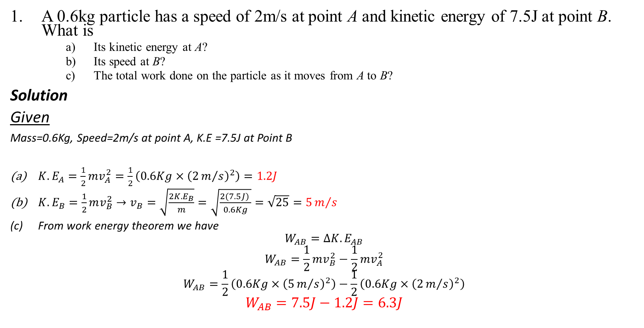
Example
A 0.6kg particle has a speed of 2m/s at point A and kinetic energy of 7.5J at point B. What is
Its kinetic energy at A?
Its speed at B?
The total work done on the particle as it moves from A to B?
Solution
Given
Mass=0.6Kg, Speed=2m/s at point A, K.E =7.5J at Point B
$K.E_{A}=\frac{1}{2}mv_{A}^{2}=\frac{1}{2}\left(0.6Kg×{\left(2m/s\right)}^{2}\right)=1.2J$
$K.E_{B}=\frac{1}{2}mv_{B}^{2}→v_{B}=\sqrt{\frac{2K.E_{B}}{m}}=\sqrt{\frac{2(7.5J) }{0.6Kg}}=\sqrt{25}=5m/s$
From work energy theorem we have
$$W_{AB}=∆K.E_{AB}$$
$$W_{AB}=\frac{1}{2}mv_{B}^{2}−\frac{1}{2}mv_{A}^{2}$$
$$W_{AB}=\frac{1}{2}\left(0.6Kg×{\left(5m/s\right)}^{2}\right)−\frac{1}{2}\left(0.6Kg×{\left(2m/s\right)}^{2}\right)$$
$$W_{AB}=7.5J−1.2J=6.3J$$

Slide 66
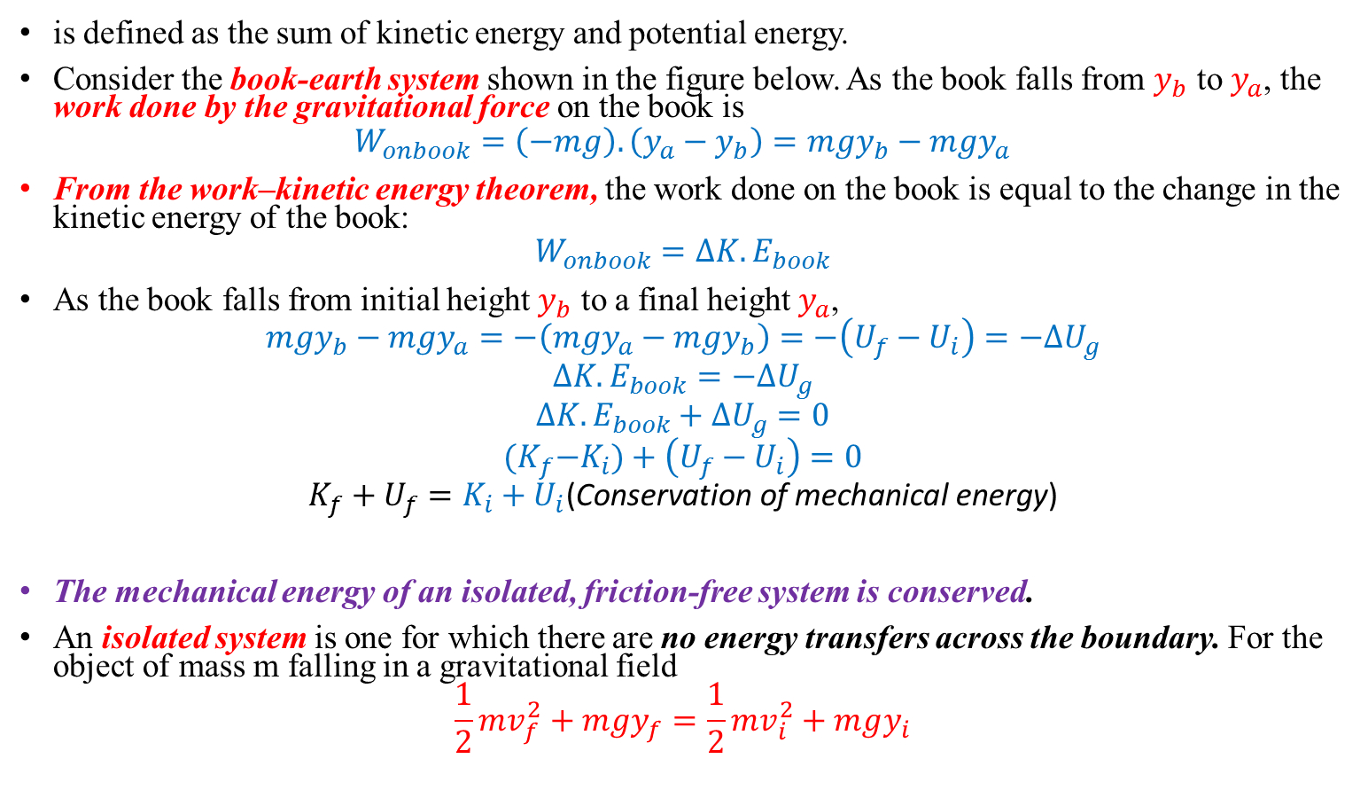
Mechanical Energy (ME):
is defined as the sum of kinetic energy and potential energy.
Consider the book-earth system shown in the figure below. As the book falls from $y_{b}$ to $y_{a}$, the work done by the gravitational force on the book is
$$W_{onbook}=\left(−mg\right).\left(y_{a}−y_{b}\right)=mgy_{b}−mgy_{a}$$
From the work–kinetic energy theorem, the work done on the book is equal to the change in the kinetic energy of the book:
$$W_{onbook}=∆K.E_{book}$$
As the book falls from initial height $y_{b}$ to a final height $y_{a}$,
$$mgy_{b}−mgy_{a}=−\left(mgy_{a}−mgy_{b}\right)=−\left(U_{f}−U_{i}\right)=−∆U_{g}$$
$$∆K.E_{book}=−∆U_{g}$$
$$∆K.E_{book}+∆U_{g}=0$$
$${(K}_{f}−K_{i})+\left(U_{f}−U_{i}\right)=0$$
$$K_{f}+U_{f}=K_{i}+U_{i}\text{(}\text{Conservation} \text{of} \text{mechanical} \text{energy}\text{)}$$
The mechanical energy of an isolated, friction-free system is conserved.
An isolated system is one for which there are no energy transfers across the boundary. For the object of mass m falling in a gravitational field
$$\frac{1}{2}mv_{f}^{2}+mgy_{f}=\frac{1}{2}mv_{i}^{2}+mgy_{i}$$

Slide 67
Example
A 3.00-kg crate slides down a ramp. The ramp is 1.00m in length and inclined at an angle of 30.0°, as shown in the figure below. The crate starts from rest at the top, experiences a constant friction force of magnitude 5.00 N, and continues to move a short distance on the horizontal floor after it leaves the ramp. Use energy methods to determine the speed of the crate at the bottom of the ramp.

Slide 68

Solution
Since the non-conservative force (friction force) exists in the system,
$$∆K.E+∆U=−f_{k}d$$
$$K.E_{f}−K.E_{i}+U_{f}−U_{i}=−f_{k}d$$
$$\frac{1}{2}mv_{f}^{2}−\frac{1}{2}mv_{i}^{2}+mgh_{f}−mgh_{i}=−f_{k}d$$
But $\frac{1}{2}mv_{i}^{2}=mgh_{f}=0 because both v_{i}=h_{f}=0$
$$\frac{1}{2}mv_{f}^{2}−mgh_{i}=−(5N)(1m)$$
$$\frac{1}{2}(3kg)v_{f}^{2}−(3Kg)(9.8m/s^{2})(0.5m)=−5J$$
$$v_{f}^{2}=6.47→v_{f}=2.54m/s$$

Slide 69

2.3.2. Power
Power is defined as the time rate of energy transfer.
If an external force is applied to an object (which we assume acts as a particle), and if the work done by this force in the time interval $Δt$ is W,
Then the average power during this interval is defined as
$$P_{av}=\frac{W}{∆t}$$
The instantaneous power P is defined as the limiting value of the average power as $∆t$ approaches zero:
$$P=\lim_{∆t→0}{\frac{W}{∆t}=\frac{W}{t}}$$
But $W=F.∆r$
$$P=\frac{W}{∆t}=\vec{F}.\frac{∆\vec{r}}{∆t}=\vec{F}.\vec{v}$$

Slide 70

Cont….
In general, power is defined for any type of energy transfer. Therefore, the most general expression for power is
$$P=\frac{E}{t}$$
The SI unit of power is joules per second (J/s), also called the watt (W) (after James Watt):
$$1W=\frac{1J}{s}=1Kg.\frac{m^{2}}{s^{3}}$$
A unit of power in the U.S. customary system is the horsepower (hp):
$$1hp=746W$$
A unit of energy (or work) can now be defined in terms of the unit of power. One kilowatt-hour (kWh) is the energy transferred in 1 h at the constant rate of 1 kW = 1 000 J/s. The amount of energy represented by 1 kWh is:
$$1KWh=\left({10}^{3}W\right)\left(3600s\right)=3.6×{10}^{6}J$$

Slide 71
Example
An older model car accelerates from rest to speed v in 10 seconds. A newer, more powerful car accelerates from rest to 2v in the same time period. What is the ratio of the power of the newer car to that of the older car?

Slide 72

Exercise
The electric motor of a model train accelerates the train from rest to 0.620 m/s in 21.0s. The total mass of the train is 875 g. Find the average power delivered to the train during the acceleration ?
Solution
$$P_{av}=\frac{W}{∆t}=\frac{{mv}^{2}}{2∆t}, W=∆K.E$$
$$P_{av}=\frac{{mv}^{2}}{2∆t}, v_{i}=0(because the object is acc.from the rest)$$
$$P_{av}=\frac{(0.875Kg)({0.62)}^{2}}{2\left(21s\right)}(\frac{Kgm^{2}}{s^{3}})$$
$$P_{av}=0.0161J$$

Slide 73

Linear Momentum
Momentum is defined as the quality of a moving object to exert a force on anything that tries to stop it.
The linear momentum of a particle or an object that can be modeled as a particle of mass m moving with a velocity $\vec{v}$ is defined to be the product of its mass and velocity:
$$\vec{P}=m\vec{v}$$
Momentum ($\vec{P}$) is a vector quantity in the direction of the velocity with SI unit kgm/s.
Using Newton‘s second law of motion, we can relate the linear momentum of a particle to the resultant force acting on the particle.
$\vec{F}=m\frac{∆\vec{v}}{∆t}=\frac{∆(m\vec{v)}}{∆t}=\frac{∆\vec{P}}{∆t}$
$$\vec{F}=\frac{∆\vec{P}}{∆t}$$

Slide 74



Therefore, the time rate of change of the linear momentum of a particle is equal to the net force acting on the particle.
$$∆\vec{P}=\vec{F}∆t$$
$$\vec{I}\left(Impulse\right)=∆\vec{P}={\vec{P}}_{f}−{\vec{P}}_{i}=\vec{F}∆t$$
The impulse of the net force $\vec{F}$ acting on the particle is equal to the change in momentum of the particle.
Conservation of Linear Momentum
Let:
${\vec{F}}_{21}$= the force on $m_{1}$ from $m_{2}$
${\vec{F}}_{12}$= the force on $m_{2}$ from $m_{1}$
Recall Newton‘s third law: When two objects of masses $m_{1}$ and $m_{2}$interact (meaning that they apply forces on each other), the force that object 2 applies to object 1 is equal in magnitude and opposite in direction to the force that object 1 applies on object 2
Fig:- Two particles interact with each other. According to Newton’s third law, we must have ${\vec{F}}_{12}=−{\vec{F}}_{21}$

Slide 75

Then,
$${\vec{F}}_{12}+{\vec{F}}_{21}=0$$
$$m_{1}{\vec{a}}_{1}+m_{2}{\vec{a}}_{2}=0$$
Then from the definition of $\vec{a}$, we have
$$m_{1}\frac{d{\vec{v}}_{1}}{dt}+m_{2}\frac{d{\vec{v}}_{2}}{dt}=0$$
$$\frac{d}{dt}\left(m_{1}{\vec{v}}_{1}+m_{2}{\vec{v}}_{2}\right)=0$$
Notice that the derivative of the sum $m_{1}{\vec{v}}_{1}+m_{2}{\vec{v}}_{2}$ with respect to time is zero. Consequently, this sum must be constant.
Then
$$m_{1}{\vec{v}}_{f1}−m_{1}{\vec{v}}_{i1}+m_{2}{\vec{v}}_{f2}−m_{2}{\vec{v}}_{i2}=0$$
$$m_{1}{\vec{v}}_{i1}+m_{2}{\vec{v}}_{i2}=m_{1}{\vec{v}}_{f1}+m_{2}{\vec{v}}_{f2}$$
$${\vec{P}}_{i1}+{\vec{P}}_{i2}={\vec{P}}_{f1}+{\vec{P}}_{f2}$$
$${\vec{P}}_{tot}={\vec{P}}_{1}+{\vec{P}}_{2}=constant {\vec{P}}_{i}={\vec{P}}_{f}$$

Slide 76

Cont..
Where ${\vec{P}}_{i1} and {\vec{P}}_{i2}$ are the initial values and ${\vec{P}}_{f1} and {\vec{P}}_{f2}$the final values of the momenta for the two particles for the time interval during which the particles interact.
This result, known as the law of conservation of linear momentum, can be extended to any number of particles in an isolated system.
We can state it as follows:
Whenever two or more particles in an isolated system interact, the total momentum of the system remains constant”.

Slide 77

Example
Solution
We choose the direction of firing of
the arrow as the positive x direction.
Identifying the archer as particle 1 and
the arrow as particle 2, we have
$$m_{1}=60Kg, m_{2}=0.03Kg and {\vec{v}}_{2f}=85\hat{i}m/s$$
Using the isolated system (momentum) model,
$$∆\vec{P}=0→{\vec{P}}_{f}−{\vec{P}}_{i}=0 →{\vec{P}}_{f}={\vec{P}}_{i}$$
$$→m_{1}{\vec{v}}_{f1}+m_{2}{\vec{v}}_{f2}=0$$
Solve this equation for ${\vec{v}}_{f1}$ and substitute numerical values:
$${\vec{v}}_{f1}=−\frac{m_{2}}{m_{1}}{\vec{v}}_{2f}=\left(\frac{0.03Kg}{60Kg}\right)\left(\frac{85\hat{i}m}{s}\right)=−0.042\hat{i}m/s$$
A 60-kg archer stands at rest on frictionless ice and fires a 0.030-kg arrow horizontally at 85 m/s (Fig.below). With what velocity does the archer move across the ice after firing the arrow?

Slide 78

2.3.4. Collisions
Consider
The collision between two particles of masses $m_{1}$ and $m_{2}$ shown in the figure below.
If the two particles form an isolated system, the momentum of the system must be conserved.
Therefore, the total momentum of an isolated system before a collision equals the total momentum of the system after the collision.
But, the total K.E of the system of particles may or may not be conserved, depending on the type of collision.
Based on Conservation kinetic energy collisions classify as
elastic and
inelastic.
Elastic collision: - An elastic collision between two objects is one in which the total kinetic energy as well as total momentum of the system is conserved.
$\left.\begin{aligned}K.E_{tot}=Conserved \\ {\vec{P}}_{tot}=Conserved \end{aligned}\right\} Elastic collision$
Perfectly elastic collisions occur between atomic and subatomic particles.

Slide 79

Consider
two particles of masses $m_{1}$ and $m_{2}$moving with initial velocities $v_{1i}$ and $v_{2i}$ along the same straight line, as shown in the figure below.
The two particles collide head-on and then leave the collision site with different velocities, $v_{1f}$ and $v_{2f}$.
If the collision is elastic, both the momentum and kinetic energy of the system are conserved. Therefore, considering velocities along the horizontal direction we have:
$m_{1}v_{1i}+m_{2}v_{2i}=m_{1}v_{1f}+m_{2}v_{2f}$……………………………1
$\frac{1}{2}m_{1}v_{1i}^{2}+\frac{1}{2}m_{2}v_{2i}^{2}=\frac{1}{2}m_{1}v_{1f}^{2}+\frac{1}{2}m_{2}v_{2f}^{2}$…………………………2
Because all velocities in the figure are either to the left or the right, they can be represented by the corresponding speeds along with algebraic signs indicating direction. We shall indicate v as positive if a particle moves to the right and negative if it moves to the left.

Slide 80

From conservation of kinetic energy,
$$\frac{1}{2}m_{1}v_{1i}^{2}+\frac{1}{2}m_{2}v_{2i}^{2}=\frac{1}{2}m_{1}v_{1f}^{2}+\frac{1}{2}m_{2}v_{2f}^{2}$$
We can cancel the factor $\frac{1}{2}$ in the equation, and rewrite as:
$$m_{1}\left(v_{1f}^{2}−v_{1i}^{2}\right)=m_{2}(v_{2f}^{2}−v_{2i}^{2})$$
Then, factor both sides
$$m_{1}\left(v_{1f}−v_{1i}\right)\left(v_{1f}+v_{1i}\right)=m_{2}\left(v_{2f}−v_{2i}\right)\left(v_{2f}+v_{2i}\right) (a)$$
Separate the terms containing $m_{1}$ and $m_{2}$
$$m_{1}\left(v_{1f}−v_{1i}\right)=m_{2}\left(v_{2f}−v_{2i}\right) (b)$$
Dividing equation (a) by equation (b)
$$\left(v_{1f}+v_{1i}\right)=\left(v_{2f}+v_{2i}\right)$$
$v_{1i}−v_{2i}=−{(v}_{1f}−v_{2f})$………………………..3
Equation (3) along with equation (1) can be used to solve problems dealing with elastic collisions.

Slide 81


B. Inelastic Collision: -
An inelastic collision is one in which the total kinetic energy of the system is not conserved. But the momentum of the system is conserved. Therefore, for inelastic collision of two particles:
$$\begin{aligned}K.E_{tot}=not conserved \\ {\vec{P}}_{tot}=Conserved \end{aligned}$$
$$m_{1}v_{1i}+m_{2}v_{2i}=m_{1}v_{1f}+m_{2}v_{2f}$$
$$\frac{1}{2}m_{1}v_{1i}^{2}+\frac{1}{2}m_{2}v_{2i}^{2}≠\frac{1}{2}m_{1}v_{1f}^{2}+\frac{1}{2}m_{2}v_{2f}^{2}$$

Slide 82


C. Perfectly Inelastic Collision: -
When the colliding objects stick together after the collision, the collision is called perfectly inelastic. Consider two particles of masses $m_{1}$ and $m_{2}$ moving with initial velocities $v_{1i}$ and $v_{2i}$ along the same straight line, as shown in the figure below.
The two particles collide head-on, stick together, and then move with some common velocity $v_{f}$ after the collision.
The total momentum before the collision equals the total momentum of the composite system after the collision
$$m_{1}v_{1i}+m_{2}v_{2i}=(m_{1}+m_{2})v_{f}$$
This gives
$$v_{f}=\frac{m_{1}v_{1i}+m_{2}v_{2i}}{(m_{1}+m_{2})}$$

Slide 83

Example 1
An archer shoots an arrow toward a target that is sliding toward her with a speed of 2.50 m/s on a smooth surface. The 22.5-g arrow is shot with a speed of 35.0 m/s and passes through the 300-g target, which is stopped by the impact. What is the speed of the arrow after passing through the target?
Solution
$m_{1}$= 22.5-g and $m_{2}$= 300-g
$v_{1i}=\text{35 }\text{m}\text{/}\text{s}{ v}_{2i}=−2.5 m/s{ v}_{2f}=\text{o} v_{1f}$=?
From conservation of linear momentum
$$m_{1}v_{1i}+m_{2}v_{2i}=m_{1}v_{1f}+m_{2}v_{2f}$$
$$v_{1f}=\frac{m_{1}v_{1i}+m_{2}v_{2i}}{m_{1}}$$
$$v_{1f}=1.67m/s$$

Slide 84

Example 2
A block of mass $m_{1}=1.6Kg$initially moving to the right with a speed of 4m/s on a horizontal frictionless track collides with a second block of mass $m_{2}=2.1Kg$ initially moving to the left with a speed of 2.5m/s. If the collision is elastic, find the velocities of the two blocks after collision. ($v_{1f}=$?, $v_{2f}=?$)
Solution
Since the collision is elastic both momentum and kinetic energy are conserved
From conservation of momentum
$$m_{1}v_{1i}+m_{2}v_{2i}=m_{1}v_{1f}+m_{2}v_{2f}$$
(1.6Kg)(4m/s)+(2.1Kg)(-2.5m/s)=(1.6Kg) $v_{1f}$+(2.1Kg) $v_{2f}$
1.6$v_{1f}$+2.1Kg$v_{2f}$=1.15 (a)
b) From conservation of kinetic energy
$$\frac{1}{2}m_{1}v_{1i}^{2}+\frac{1}{2}m_{2}v_{2i}^{2}=\frac{1}{2}m_{1}v_{1f}^{2}+\frac{1}{2}m_{2}v_{2f}^{2}$$
We have
$$\left(v_{1f}+v_{1i}\right)=\left(v_{2f}+v_{2i}\right)$$
$$v_{1f}−v_{2f}=v_{1i}−v_{2i}$$
$$v_{1f}−v_{2f}=−2.5m/s−4m/s$$
$v_{1f}−v_{2f}=−6.5m/s$ (b)
Solving equation (a) and (b) simultaneously
$$v_{1f}=−3.38m/s$$
$$v_{2f}=3.12m/s$$

Slide 85

2.3.5. Center of Mass
The center of mass is the point at which all the mass can be considered to be "concentrated".
The center of mass of the system is located somewhere on the line joining the particles and is closer to the particle having the larger mass.
The center of mass of the pair of particles located on the x-axis as shown in the figure below lies somewhere between the particles, it is given by:
$$x_{CM}=\frac{m_{1}x_{1}+m_{2}x_{2}}{m_{1}+m_{2}}$$

Slide 86


We can extend this concept to a system of many particles with masses $m_{i}$ in three dimensions.
The x coordinate of the center of mass of n particles is defined to be
$$x_{CM}=\frac{m_{1}x_{1}+m_{2}x_{2}+m_{3}x_{3}…{+m}_{n}x_{n}}{m_{1}+m_{2}+m_{3}…….+m_{n}}=\frac{\sum_{i}{m_{i}x_{i}}}{\sum_{i}{m_{i}}}=\frac{\sum_{i}{m_{i}x_{i}}}{M}$$
Similarly, the y and z coordinates
$$y_{CM}=\frac{\sum_{i}{m_{i}y_{i}}}{M} and z_{CM}=\frac{\sum_{i}{m_{i}z_{i}}}{M}$$
Therefore,
$${\vec{r}}_{CM}=x_{CM}\hat{i}+y_{CM}\hat{j}+z_{CM}\hat{k}=\frac{\sum_{i}{m_{i}x_{i}\hat{i}+\sum_{i}{m_{i}y_{i}\hat{j}}+\sum_{i}{m_{i}z_{i}\hat{k}}}}{M}$$
$${\vec{r}}_{CM}=\frac{\sum_{i}{m_{i}{\vec{r}}_{i}}}{M}$$

Slide 87
Example

Slide 88

Chapter Summery
Kinematics is the study of motion of objects without considering the agents that cause the motion, and Dynamics is the study of motion of objects with the cause of the motion. For motion with constant acceleration,
$\vec{v}=\vec{u}+\vec{a}t$ ${\vec{v}}_{av}=\frac{\vec{v}+\vec{u}}{2}$
$${\vec{r}}_{f}−{\vec{r}}_{i}=\vec{u}t+\frac{1}{2}\vec{a}t^{2} v^{2}=u^{2}+2a∆r$$
Projectile motion is a motion in a curved path in a gravitational field. The maximum height of the projectile is given by
$$h=\frac{u^{2}\sin^{2}θ}{2g}$$
The Range(R) is the horizontal displacement of the projectile covered in a total time of flight ($t_{tot}=\frac{2usinθ}{g}$,$R=\frac{u^{2}sin2θ}{g}$)
Force: any interaction that changes the motion an object.
Friction force is always proportional to the normal force between the two interacting surfaces.
$$F_{frict}∝F_{norm}$$
There are two types of frictional force: Static friction, Kinetic friction:
Uniform Circular Motion is motion of objects in a circular path with a constant speed. For objects moving in a circular path with a constant speed, acceleration arises because of the change in direction of the velocity, and such acceleration is called the centripetal acceleration
$$a_{c}=\frac{V^{2}}{r}$$

Slide 89


Summary……
Kinetic energy is represents the energy associated with the motion of the particle:
$$K.E=\frac{1}{2}mv^{2}$$
Potential energy is the energy associated with the configuration of a system of objects that exert forces on each other. The potential energy concept can be used only when dealing with a special class of forces called conservative forces.
$$U_{g}=mgy$$
Power is defined as the time rate of energy transfer:
$$P_{av}=\frac{W}{∆t}$$
Momentum is defined as the quality of a moving object to exert a force on anything that tries to stop it.
$\vec{P}=m\vec{v}$
The center of mass is the point at which all the mass can be considered to be "concentrated".
$${\vec{r}}_{CM}=\frac{\sum_{i}{m_{i}{\vec{r}}_{i}}}{M}$$
Newton’s universal law of gravitation
states that the force is directly proportional to the product of their masses and inversely proportional to the square of the distance between them
$$\vec{F}=\frac{GmM}{r^{2}}\hat{r}$$
Weightlessness is simply a sensation experienced by an individual when there are no external objects touching one's body and exerting a push or pull upon it.
The work (W) done on a system by an agent exerting a constant force ($\vec{F}$)and moving the system through the displacement ($∆\vec{r}$) is
$$W=\text{(}\vec{F}.∆\vec{r})=\left|\vec{F}\right|\left|∆\vec{r}\right|cosθ$$
Energy

Slide 90
Chapter Three
Fluid Mechanics

Slide 91
Fluid mechanics
Fluid mechanics is the branch of physics concerned with the mechanics of fluids in motion (fluid dynamics) or at rest (fluid statics) and the forces on them.
This study area deals with many and diversified problems such as surface tension, fluid statics, flow in enclose bodies, or flow round bodies (solid or otherwise), flow stability, etc.
The applications of fluid mechanics are enormous:
breathing, blood flow, swimming, pumps, fans, turbines, airplanes, ships, rivers, windmills, pipes, missiles, icebergs, engines, filters, jets, and sprinklers, to name a few.
In physics, a fluid is a substance that continually deforms (flows) under an applied shear stress, or external force.
Fluids are a phase of matter and include liquids and gases.

Slide 92
Properties of Bulk Matter
States of Matter
Solid
Has a definite volume and shape
Liquid
Has a definite volume but not a definite shape
Gas – unconfined
Has neither a definite volume nor shape
Fluids
A fluid is a collection of molecules that are randomly arranged and held together by weak cohesive forces and by forces exerted by the walls of a container.
Both liquids and gases are fluids.
Fluids do not sustain shearing stresses or tensile stresses.
The only stress that can be exerted on an object submerged in a static fluid is one that tends to compress the object from all sides.
The force exerted by a static fluid on an object is always perpendicular to the surfaces of the object.

Slide 93
Bulk matter…..
A sufficiently large force will permanently deform or break an object, but otherwise, when the external forces are removed, the object tends to return to its original shape and size. This is called elastic behavior.
Definitions:
Elastic materials are materials that regain their original shape and size when the deforming force is removed.
Elastic deformation is a reversible deformation by a force applied within the elastic limit. Beyond elastic limit, a force applied on an object causes permanent and irreversible deformation called plastic deformation.

Slide 94

Plastics materials: do not regain their original shape and size when the deforming force is removed.
The elastic properties of solid materials are described in terms of stress and strain.
Stress is the force per unit area that is causing some deformation on an object.
It has SI unit N/m2 called the Pascal (Pa), the same as the unit of pressure
$stress=\frac{F}{A}$ ……………………………3.1
Strain:- measures the amount of deformation by the applied stress and defined as the change in configuration of a body divided by its initial configuration. Strain is unit less quantity.
$strain=\frac{change in configuration}{initial Configuration}$…………………..3.2

Slide 95

There are three kinds of strains:
Tensile Strain: When the ends of a bar(rod or wire) of uniform cross-sectional area A are pulled with equal and opposite forces of magnitude F⊥ (Figure 1(a)), the bar will undergo a stretch by the tensile stress defined as the ratio of the force magnitude F⊥ to the cross-sectional area A:
$Tensile stress=\frac{F_{\text{⊥}}}{A}$………………3.3
Tensile stress :-The fractional change in length of an object under a tensile stress is called the tensile strain (Figure 1b)
$Tensile strain=\frac{∆l}{l_{0}}$………………3.4

Slide 97

2. Shear Stress and Strain
Another type of deformation occurs when an object is subjected to a force parallel to one of its faces while the opposite face is held fixed by another force (Figure (a) below).
The stress in this case is called a shear stress. If the object is originally a rectangular block, a shear stress results in a shape whose cross section is a parallelogram.
$shear stress=\frac{∆F}{A}$……………..3.5

Slide 98

A book pushed sideways, as shown in Figure (b) below, is an example of an object subjected to a shear stress.
To a first approximation (for small distortions), no change in volume occurs with this deformation.
We define the shear stress as F/A, the ratio of the tangential force to the area A of the face being sheared.
The shear strain is defined as the ratio x/h, where x is the horizontal distance that the sheared face moves and h is the height of the object. In terms of these quantities, the shear modulus is
$shear strain=\frac{x}{h}=tanφ$……………..3.6

Slide 99

3. Volume Stress and Strain
Volume Stress is a stress which causes volume deformation on an object and defined as the ratio of the change in the magnitude of the applied force ΔF to the surface area A.
$$volume stress=\frac{∆F}{A}=∆P………………3.7$$
Volume strain is the fractional change in volume (Figure 3) that is - the change in volume, ΔV , divided by the original volume V0:
$$volume stress=\frac{∆V}{V_{0}}………………3.8$$
Fig. A block undergoing volume strain by the applied volume stress

Slide 100

Elasticity Moduli
The stress will be proportional to the strain if the stress is sufficiently small.
In this regard, the proportionality constant known as elastic modulus depends on the material being deformed and on the nature of the deformation.
$$stress∝strain$$
$$stress=elastic modulus×strain…………..3.8$$
This relationship between stress and strain is similar to Hooke‘s law ($F_{s}=−k∆x$ ), relationship between force and extension of a spring.
The elastic modulus is similar to a spring constant.
Generally as stress increase, strain increase, as spring force increase change in displacement increase.

Slide 101

Corresponding to the three types of strains, there are three types of elastic module.
Young‘s Modulus(Y): is the ratio of the tensile stress to the tensile strain.
It measures the resistance of a solid to a change in its length and typically used to characterize a rod or wire stressed under either tension or compression.
Note that because strain is a dimensionless quantity, Y has units of force per unit area.
Typical values are given in Table 3.1. Experiments show (a) that for a fixed applied force, the change in length is proportional to the original length and (b) that the force necessary to produce a given strain is proportional to the cross-sectional area.
$Y=\frac{tensile stress}{tensile strain }=\frac{{F_{⊥}}/A}{{∆l}/{l_{0}}}$………………………………3.9

Slide 102

2. Shear Modulus (S): with units of Pascal, is the ratio of shear stress to shear strain.
It is the measure of the resistance to motion of the planes within a solid parallel to each other.
A material having a large shear modulus is difficult to bend.
Like Young‘s modulus, the unit of shear modulus is the ratio of that for force to that for area.
$S=\frac{shear stress}{shear strain }=\frac{{F_{||}}/A}{x/h}$…………………………3.10

Slide 103

3. Bulk Modulus: its SI unit is Pascal, is the ratio of the volume stress to the volume strain.
Bulk modulus measures the resistance of solids or liquids to changes in their volume.
A material having a large bulk modulus doesn‘t compress easily.
Note that a negative sign is included in this defining equation so that B is always positive.
An increase in pressure (positive ΔP) causes a decrease in volume negative ΔV) and vice versa
$B=\frac{Volume stress}{Volume strain }=\frac{−{∆F}/A}{{∆V}/{V_{0}}}=\frac{−∆P}{{∆V}/{V_{0}}}$…………………………3.10
A negative sign is inserted in this defining equation so that B is a positive number. This operation is necessary because an increase in pressure (positive ) causes a decrease in volume (negative ) and vice versa.

Slide 104

The reciprocal of the bulk modulus is called the compressibility of the material.
Note:- both solids and liquids have a bulk modulus.(see from the table)
However, no shear modulus and no Young‘s modulus are given for liquids
because a liquid does not sustain a shearing stress or a tensile stress.
If a shearing force or a tensile force is applied to a liquid, the liquid simply flows in response.
Strain Energy is energy stored in a stretched wire. If x is the stretch due to applied force F,
$strain energy=\frac{1}{2}Kx^{2}$……………………3.12

Slide 105
Table : Typical Values for Elastic Moduli

Slide 106

Example:
Suppose that the tension in the cable is 940 N as the actor reaches the lowest point. What diameter should a 10-m-long steel wire have if we do not want it to stretch more than 0.5 cm under these conditions?
Solution:
From the definition of Young‘s modulus, we can solve for the required cross-sectional area. Assuming that the cross section is circular, we can determine the diameter of the wire. From Equation:
$$Y=\frac{{F_{⊥}}/A}{{∆l}/{l_{0}}}→A=\frac{Fl_{0}}{Y∆l}$$
$$A=\frac{(940N)(10m)}{(20×{10}^{10}N/m^{2})(0.005m) }=9.4×{10}^{−6}m^{2}$$
Because of $A=πr^{2}$ the radius of the wire can be found from
$$r^{2}=\frac{A}{π}→r=\sqrt{\frac{A}{π}}=\sqrt{\frac{9.4×{10}^{−6}m^{2}}{π}}=1.7×{10}^{−3}m=1.7mm$$
$$d=2r=2\left(1.7mm\right)=3.4mm$$

Slide 107

Activity:
A solid brass sphere is initially surrounded by air, and the air pressure exerted on it is $1×{10}^{5}N/m^{2}$ (normal atmospheric pressure). The sphere is lowered into the ocean to a depth where the pressure is $2×{10}^{7}N/m^{2}$. The volume of the sphere in air is 0.50 $m^{3}$. By how much does this volume change once the sphere is submerged?
Solution
$$B=\frac{Volume stress}{Volume strain }=\frac{−{∆F}/A}{{∆V}/{V_{0}}}=\frac{−∆P}{{∆V}/{V_{0}}}$$
$$∆V=−∆P×\frac{V_{0}}{B}, B=6.1×{10}^{10}for solid brass$$
$$∆V=−(2×{10}^{7}−1×{10}^{5})N/m^{2}\frac{\text{0.50 }m^{3}}{(6.1×{10}^{10})N/m^{2}}$$
Then
$$∆V=−8.19{ m}^{3}$$

Slide 108

3.2. Density and Pressure in Static Fluids
Density (ρ) is the quantity of mass (m) per unit volume (V) of a body with SI unit $Kg/m^{3}$ and given by:
$$ρ=\frac{m}{v}−−−−−−−−−−−−−−(3.13)$$
Specific gravity (SG): also called relative density (it relates density of two substances)
is the ratio of the density of the substance to the density of another substance which is taken as a standard.
Equivalently it is the ratio of the mass of a substance to the mass of a reference substance for the same given volume
The reference Substance for liquids is nearly always Water at its densest (at $4℃$ or 39.2 $℉$) the density of pure water at is usually taken as the standard and this has been defined to be exactly $1×{10}^{3}Kg/m^{3}$.
For gases it is air at room temperature ($20℃$ or 68 $℉$)

Slide 109

Nonetheless, the temperature and pressure must be specified for both the sample and reference or standard. Pressure is nearly always 1 atm (101.325kPa).
Then generally Specific gravity(SG)
$$SG_{true}=\frac{ρ_{sample}}{ρ_{H_{2}O}}$$
Specific gravity is a dimensionless quantity and the same in any system of measurement.
For example,
the density of aluminum is $2.7×{10}^{3}Kg/m^{3}$; therefore,
The SG of aluminum is
$$SG=\frac{2.7×{10}^{3}Kg/m^{3}}{1×{10}^{3}Kg/m^{3}}=2.7$$

Slide 110

Example: A solid sphere made of wood has a radius of 0.1 m. The mass of the sphere is 1.0 kg. Determine a) density and b) specific gravity of the wood.
Solution:
The volume of the sphere wood,
$V=\frac{4}{3}πr^{3}=\frac{4}{3}×3.14×({0.1)}^{3}=4.18×{10}^{−3}m^{3}$
The density of the wood,
$$ρ=\frac{m}{v}=\frac{1Kg}{4.18×{10}^{−3}m^{3}}=239{Kg}/{m^{3}}$$
b) Specific gravity of the wood,
$$SG=\frac{mdensity of wood }{density of water}=\frac{239{Kg}/{m^{3}}}{1000Kg/m^{3}}=0.239$$

Slide 111

Pressure
Is the ratio of the force acting perpendicular to s surface to the surface area (A) on which the force acts.
SI unit of pressure is $N/m^{2}$, called Pascal (Pa).
Another commonly used pressure unit is atmosphere (atm) equal to 101.3 kPa, which is the average pressure, exerted by the Earth‘s atmosphere at sea level.
$$P=\frac{F⊥}{A}$$
The pressure produced by the column of fluid of height h and density $ρ$ is given by:
$$P_{fluid}=ρgh$$

Slide 112

The density of liquids and solids is considered to be constant.
In reality, the density of a liquid will increase slightly with increasing depth (Why?). The variation in density is usually negligible and can be ignored.
Note that:
All points at same level in a fluid have same pressure.
Fluid pressure increases with increase in the depth of the fluid.
Fluid pressure does not depend on the shape of the container.
Atmospheric Pressure: is the pressure due to the weight of the atmosphere exerted on the surface of the Earth. Atmospheric pressure decreases with increase in altitude as a result of decrease in the density of the air.
Gauge pressure: is the difference in pressure between a system and the surrounding atmosphere.
$$P_{gauge}=P_{system}−P_{atmosphere}$$

Slide 113

Because gauge pressure is the pressure relative to atmospheric pressure, therefore, it is positive for pressures above atmospheric pressure, and negative for pressures below it.
Absolute Pressure: In fact, atmospheric pressure does add to the pressure in any fluid not enclosed in a rigid container. This happens because of Pascal‘s principle. The total pressure, or absolute pressure, is thus the sum of gauge pressure and atmospheric pressure:
$$P_{absolute}=P_{gauge}+P_{atmosphere}$$
In most cases the absolute pressure in fluids cannot be negative.
Fluids push rather than pull, so the smallest absolute pressure is zero. (A negative absolute pressure is a pull.) Thus the smallest possible gauge pressure is $P_{gauge}=−P_{atmosphere}$

Slide 114

Example
A submerged wreck is located 18.3 m beneath the surface of the ocean off the coast of South Florida. Determine the a) gauge pressure and b) absolute pressure on a scuba diver who is exploring the wreck. Note: the density of sea water is$1025Kg/m^{3}$ .
Solution
$P_{gauge}=ρgh=(1025Kg/m^{3})$($9.8 m/s^{2}$)(18.3m)=$1.83×{10}^{5} \frac{N}{m^{2}}=183kPa$
$P_{abs}=P_{gauge}+P_{atm}=\left(1.83×{10}^{5}+1.013×{10}^{5}\right)\frac{N}{m^{2}}=2.84×{10}^{5}\frac{N}{m^{2}}=284kPa$

Slide 115

3.3. Buoyant Force and Archimedes’ Principles
Pascal’s Principle –
sates that pressure applied to a confined fluid in a container is transmitted equally to all regions of the fluid and to the walls of the container.
An important application of Pascal‘s principle is the hydraulic press (Figure 4). A downward force ${\vec{F}}_{1}$ applied to a small piston of area $A_{1}$ causes a pressure of $P_{1}=\frac{{\vec{F}}_{1}}{A_{1}}$ .
The pressure is transmitted throughout the fluid and reaches the larger piston of area $A_{2}$ without any change.

Slide 116

As the fluid moves it pushes the larger piston with ${\vec{F}}_{2}$ and exerts a pressure of $P_{2}=\frac{{\vec{F}}_{2}}{A_{2}}$ .
According to Pascal‘s principle, these two pressures are equal implying:
$\frac{{\vec{F}}_{1}}{A_{1}}=\frac{{\vec{F}}_{2}}{A_{2}}$………………………………(3.18)
Example
The small piston of a hydraulic lift has an area of $0.20m^{2}$. A car weighing $1.2×{10}^{4}N$ sits on a rack mounted on the large piston. The large piston has an area of $0.90m^{2}$. How large force must be applied to the small piston to support the car?
Solution
$A_{1}=0.20m^{2}$.
$A_{2}=0.90m^{2}$.
$F_{2}=1.2×{10}^{4}N$.
$F_{1}=?$.
Then $\frac{{\vec{F}}_{1}}{A_{1}}=\frac{{\vec{F}}_{2}}{A_{2}}→F_{1}=\frac{{\vec{F}}_{2}}{A_{2}}×A_{1}$
$$F_{1}=\frac{1.2×{10}^{4}N}{0.90m^{2}\text{. }}×0.20m^{2}=2.7×{10}^{3}N\text{.}$$

Slide 117

3.3.1. Archimedes’ principle
Any object which is partially or totally submerged in a liquid has buoyant force acting on it which pushes the object up.
That is why a rock appears to weigh less when it is submerged in liquid, or why it is very difficult to push a beach ball under water.
The famous Greek mathematician, Archimedes‘ developed a principle which describes this around 250 B.C.
Archimedes‘ principle can be stated as
Anybody completely or partially submerged in a fluid is buoyed up by a force equal to the weight of the fluid displaced by the body.
$$F_{bouyant}=W_{fluid}=ρ_{fluid}V_{displaced}g_{fluid}………..(3.19)$$

Slide 118

Where, $F_{bouyant}$ is the magnitude of the buoyant force and $W_{fluid}$ is the weight of the displaced fluid.
The reason for this is that the pressure of the fluid is dependent on the depth of the fluid.
So the pressure at the top of an object is less than the pressure at the bottom of the object which creates a net force.

Slide 119


Example:
A sample of an unknown material weighs 300 N in air and 200 N when submerged in an alcohol solution with a density of $0.70×{10}^{3}Kg/m^{3}$. What is the density of the material?

Slide 120
3.4. Moving Fluids and Bernoulli Equations (Fluid Dynamics)
Up until this point, we have discussed fluids which are static. That is, they are not in motion.
We now turn our attention to fluids in motion, or hydro dynamics.
There are many categories of fluids in motion, categorized by whether
the fluid flow is steady, or not steady,
compressible or incompressible,
viscous or non-viscous.
In steady flow, the velocity of the fluid particles at any point is constant as time goes by. Different parts of the fluid may be flowing at different rates, but the fluid in one location is always flowing at the same rate.
An in compressible flow is the flow of a fluid which cannot be compressed. Most liquids are nearly incompressible.
A viscous fluid is one which does not flow easily, like honey, while a non-viscous fluid is one which flows more easily, like water.
We will mostly be concerned with the steady flow of in compressible, non-viscous fluids.

Slide 121
If the flow is steady, then the velocity of the fluid particles at any point is a constant with time. The various layers of the fluid slide smoothly past each other. This is called streamline or laminar flow. It assumes that as each particle in the fluid passes a certain point it follows the same path as the particles that preceded it. There is no loss of energy due to internal friction in the fluid, which is the fluid, is assumed to travel smoothly in regular layers; the velocity and pressure remain constant at every point in the fluid.
Above some certain velocity, the flow is not smooth and becomes turbulent. Illustrations of turbulent and laminar flow are shown in Figure 3.5. Turbulent flow is the irregular movement of particles in a fluid and results in loss of energy due to internal friction between neighboring layers of the fluid, called viscosity. There is disruption to the layers of fluid; the speed of the fluid at any point is continuously changing both in magnitude and direction.

Slide 122
Factors affecting laminar flow are
density,
compressibility,
temperature and
viscosity of the fluid.
Assumptions made in the ideal fluid flow to understand the complex motions of real fluids:
The fluid is non-viscous, i.e there is no internal friction between adjacent layers.
The flow is steady; the velocity of the fluid at each point remains constant.
The fluid is incompressible; density of the fluid is constant.
The flow is irrotational; the fluid has no angular momentum about any point.

Slide 123

Equation of Continuity
Equation of continuity expresses conservation of mass for an incompressible fluid flowing in a tube. It says:
“the amount (either mass or volume) of fluid flowing through a cross section of the tube in a given time interval must be the same for all cross sections”,
Or
“the product of the area and the fluid speed at all points along a tube is constant for an incompressible fluid”
$$Av=A_{1}v_{1}=A_{2}v_{2}……………(3.20)$$

Slide 124

We see that if the cross sectional area is decreased, and then the flow rate increases. This is demonstrated when you hold your finger over part of the outlet of a garden hose. Because you decrease the cross sectional area, the water velocity increases. The product Av, which has the dimensions of volume per unit time, is called the flow rate. The condition Av = constant is equivalent to the statement that the volume of fluid that enters one end of a tube in a given time interval equals the volume leaving the other end of the tube in the same time interval if no leaks are present
$$Flow Rate=\frac{Volume}{time}=Av=constant$$

Slide 125
3.4.1. Bernoulli’s Equation
In the 18th century, the Swiss physicists Daniel Bernoulli derived a relationship between the velocity of a fluid and the pressure it exerts.
Qualitatively, Bernoulli‘s principle states that swiftly moving fluids exert less pressure than slowly moving fluids.
Bernoulli‘s principle is extremely important in our everyday life.
It is the primary principle which leads to lift on an airplane wing and allows the plane to fly. It is the primary reason a sailboat can sail into the wind. It is the primary reason a baseball can curve. It is an important reason that smoke is drawn up a chimney.
Bernoulli‘s equation is really a consequence of a fundamental principle of physics: the conservation of energy.
It can be derived using energy principles.

Slide 126

Consider a fluid moving through a pipe. The pipe‘s cross sectional area changes, and the pipe changes elevation. At one point the pipe has a cross sectional area of $A_{1}$, a height of $y_{1}$, a pressure of $P_{1}$, a velocity of $v_{1}$ and moves a distance of $∆x_{1}$ in a time of $∆t_{1}$. At another point $P_{1}$ along the pipe these quantities are given by $A_{2}, y_{2}, P_{2},v_{2},$and $∆x_{2}$.
Conservation of energy gives the following equation, called Bernoulli‘s equation,
$$P+\frac{1}{2}ρv^{2}+ρgy=constant……………..(3.22)$$
$$P_{1}+\frac{1}{2}ρv_{1}^{2}+ρgy_{1}=P_{2}+\frac{1}{2}ρv_{2}^{2}+ρgy_{2}……(3.23)$$

Slide 128

Example
Water circulates throughout a house in a hot water heating system. If the water is pumped at a speed of 0.50 m/s through a 4.0 cm diameter pipe in the basement under a pressure of $3.03×{10}^{3}Pa$, what will be the velocity and pressure in a 2.6 cm diameter pipe on the second floor 5.0m above?

